Slide 1

PAŞABAHÇE
CRYSTALLIN
Ассортимент
Новинки

Slide 2
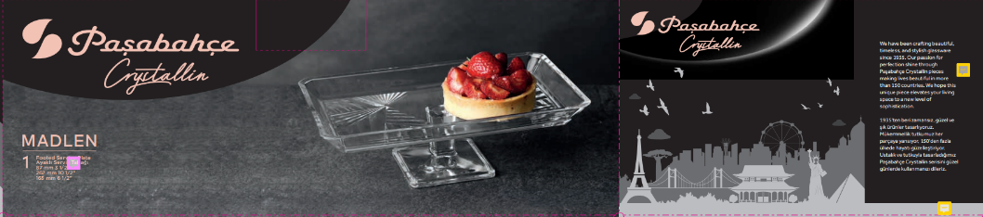
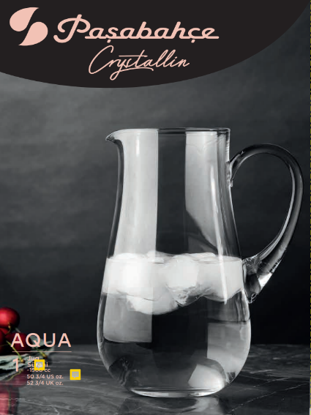
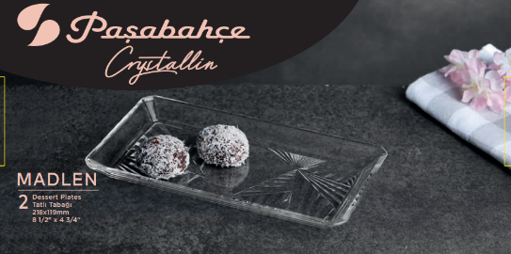

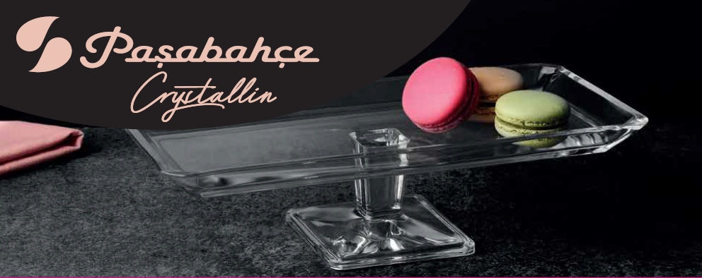
Paşabahçe crystallın
 | Mold | 35
Автоматическое пр-во | Sku | 37
 | Novelty | 7
 | Mold | 44
Ручное пр-во | Sku | 44
 | Mold | 79
Всего | Sku | 81

Slide 3
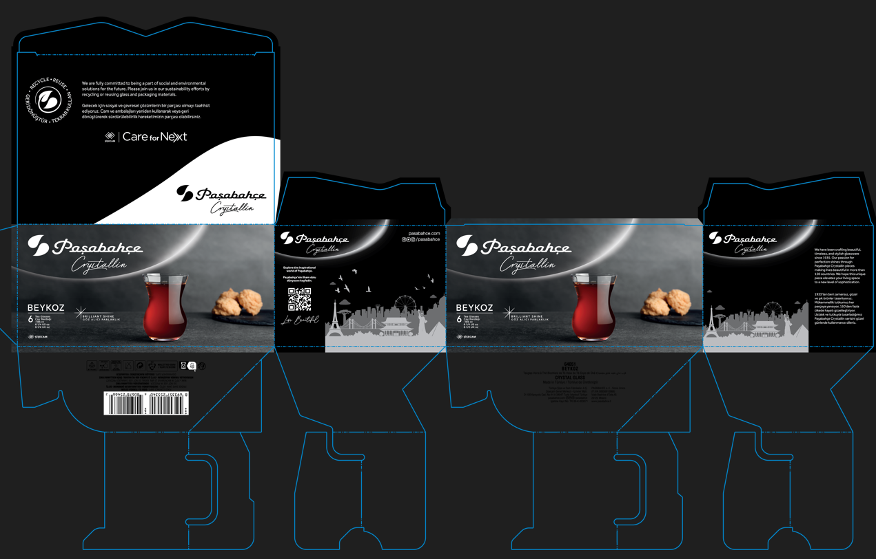
Paşabahçe crystallın

Slide 4
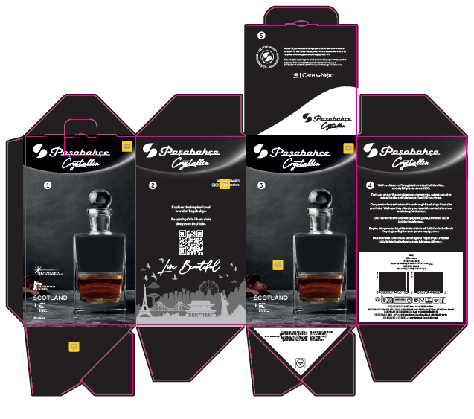
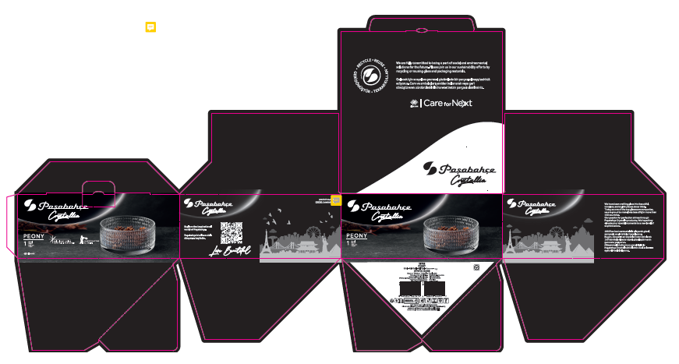
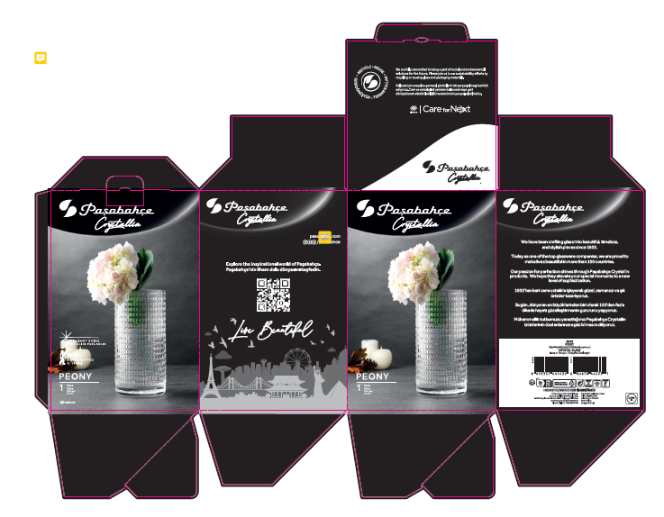
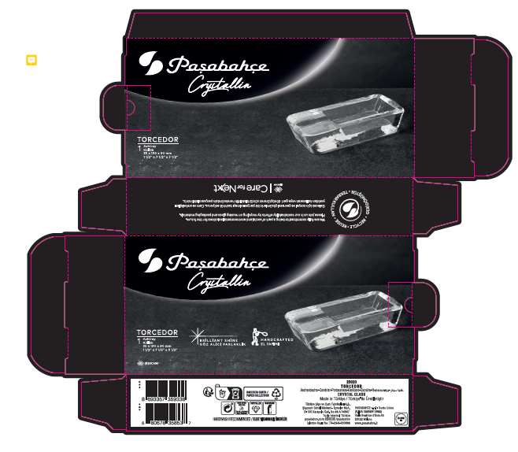
Paşabahçe crystallın

Slide 5
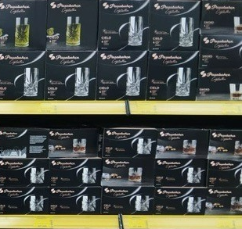
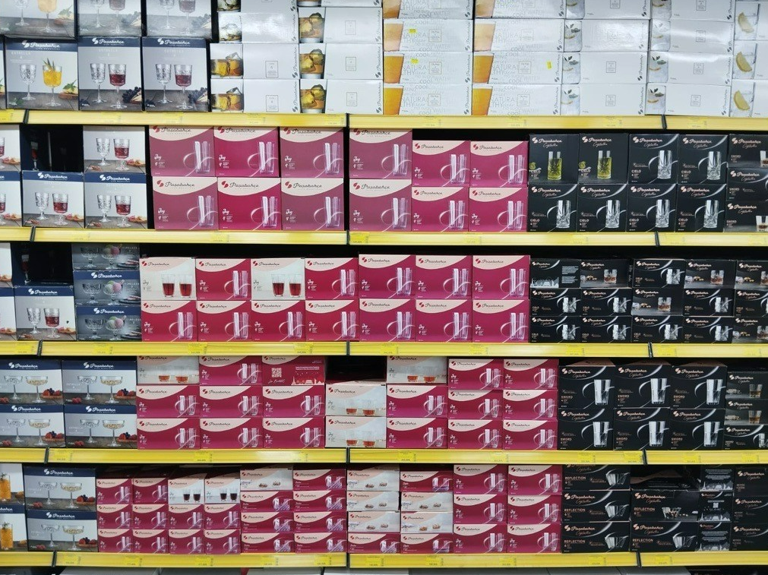
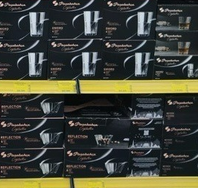
Paşabahçe crystallın

Slide 6
Paşabahçe crystallın
Ручное пр-во

Slide 7
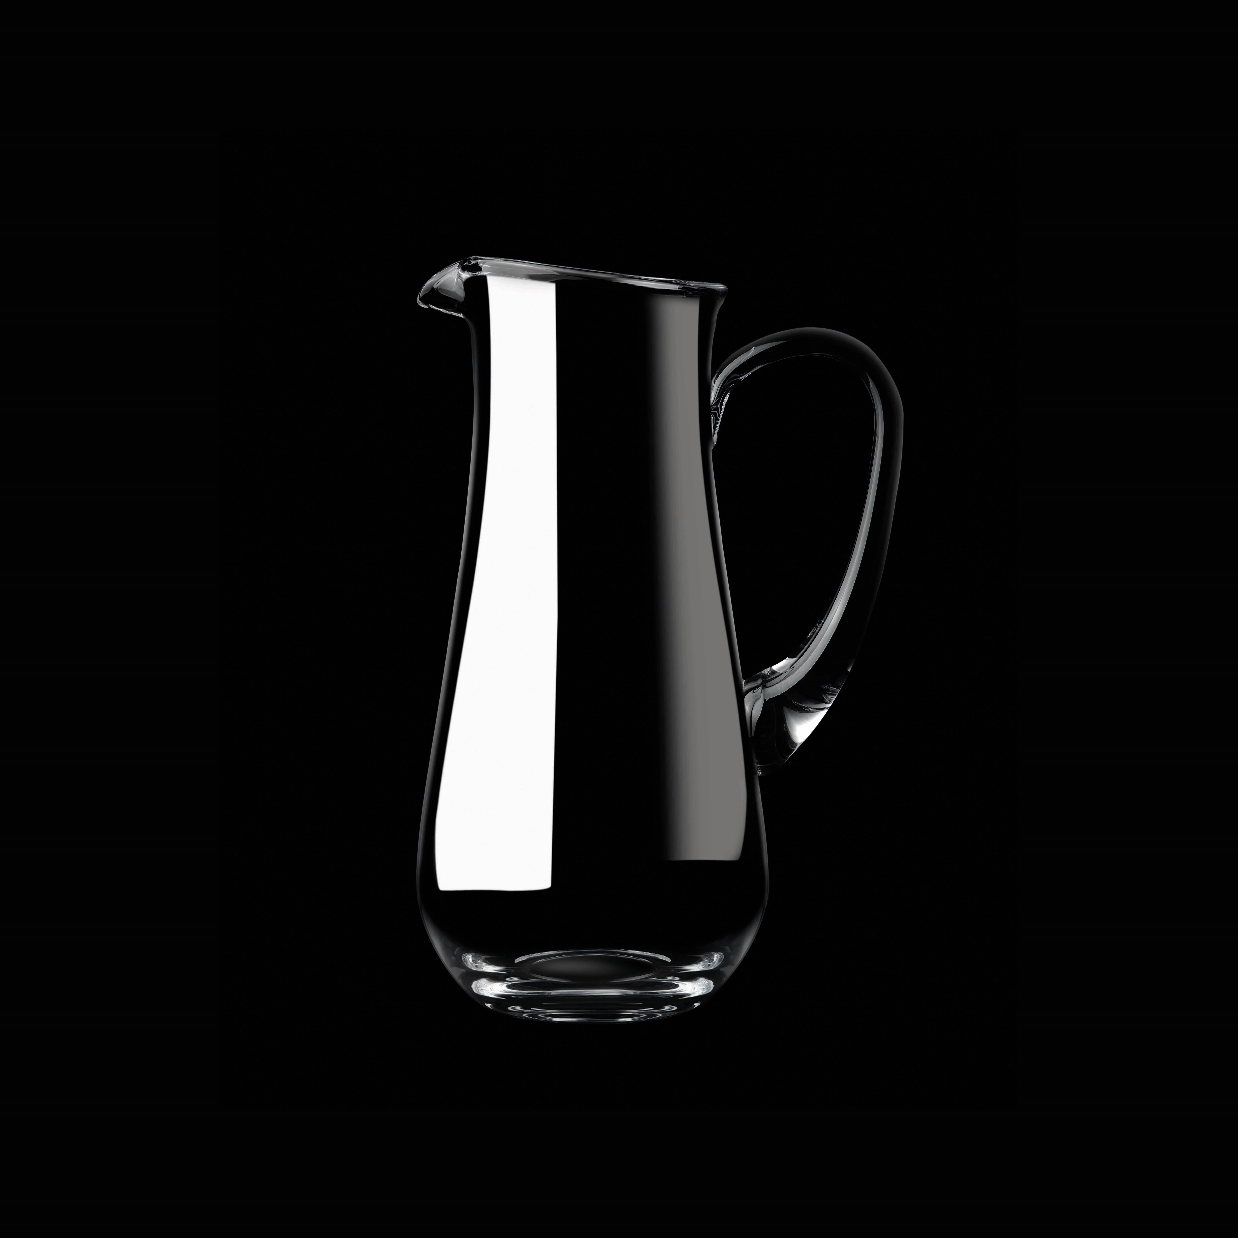
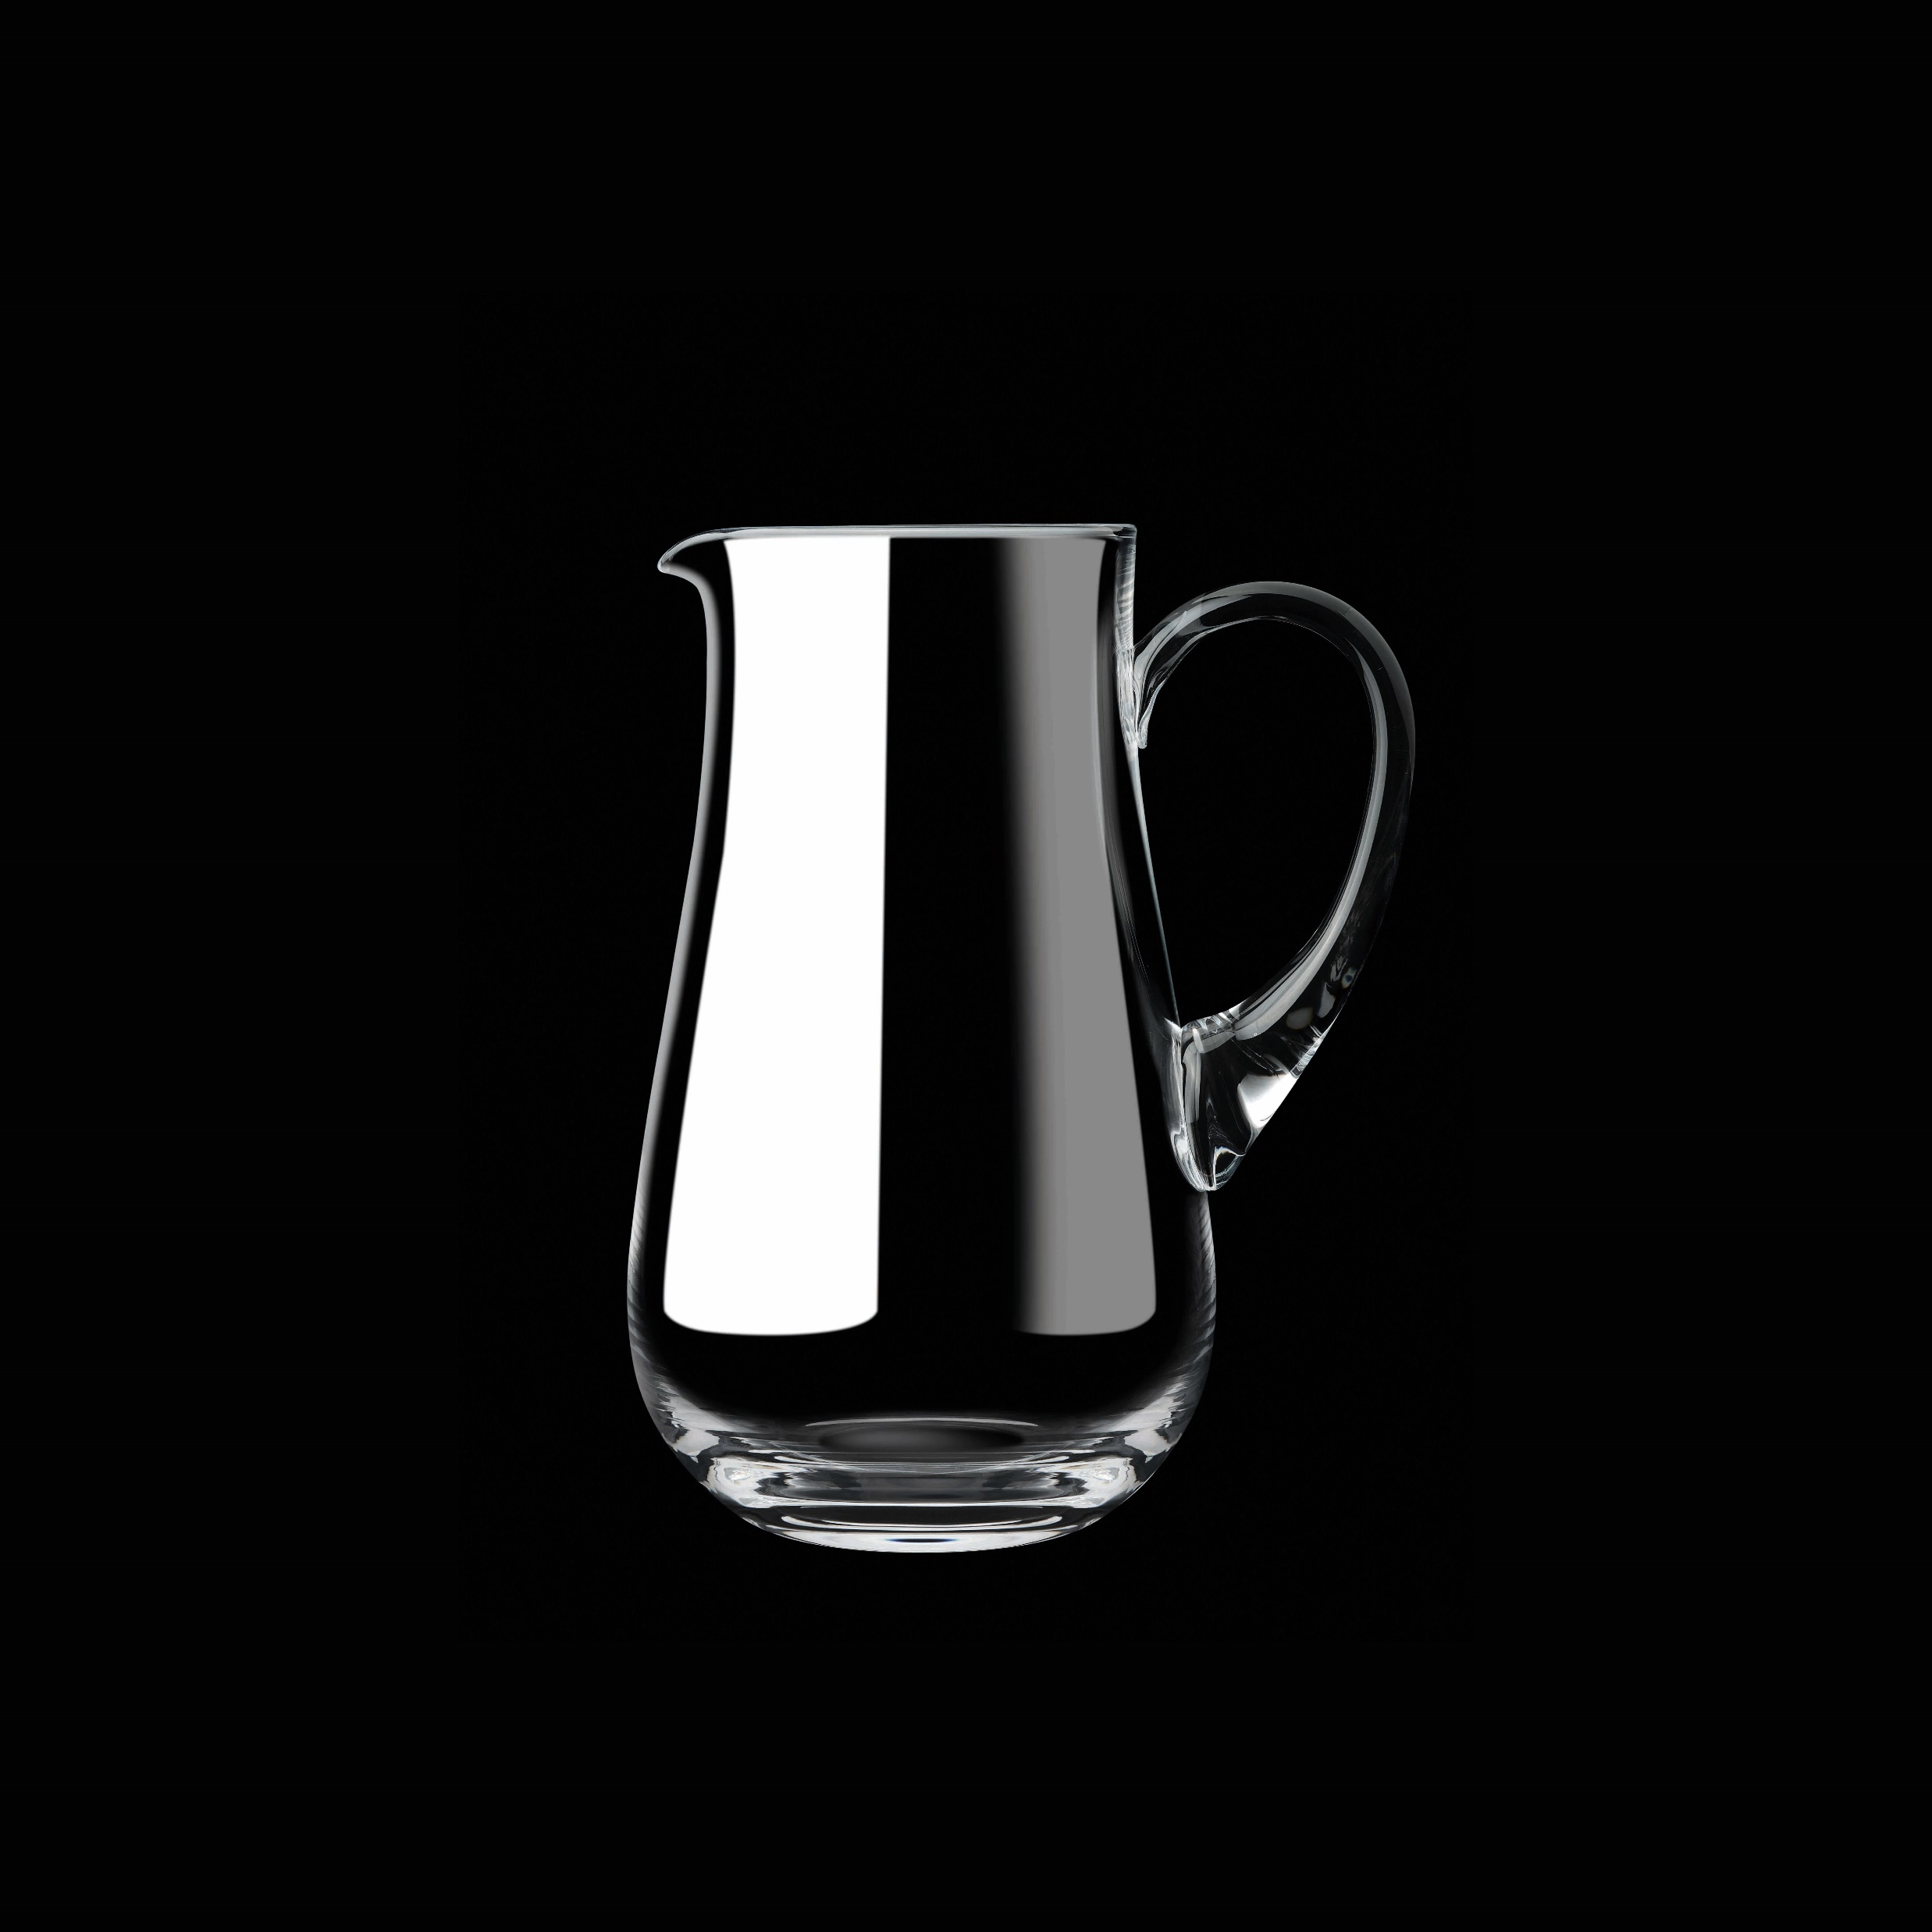
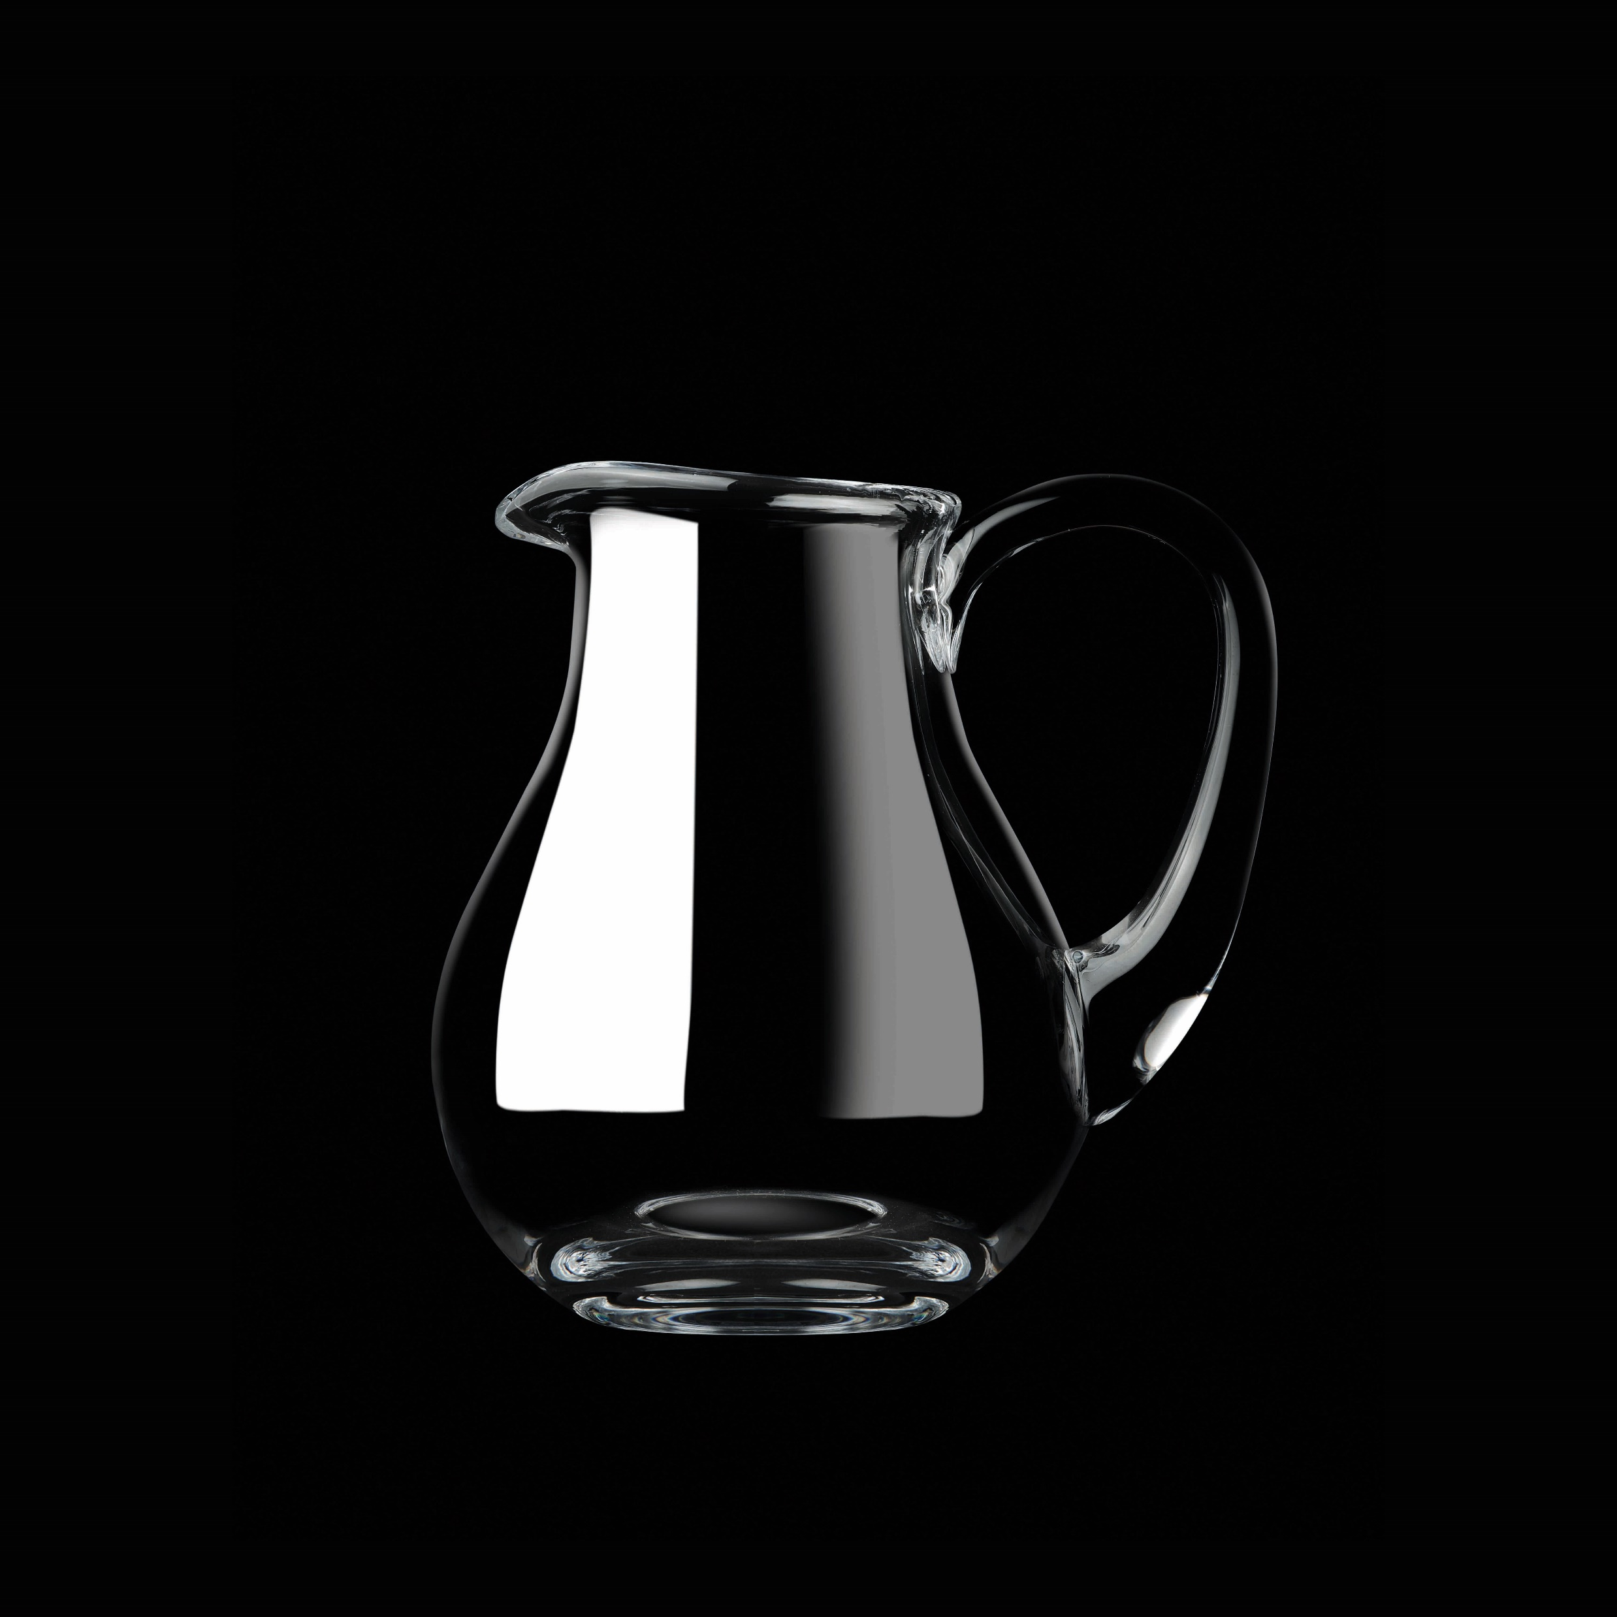
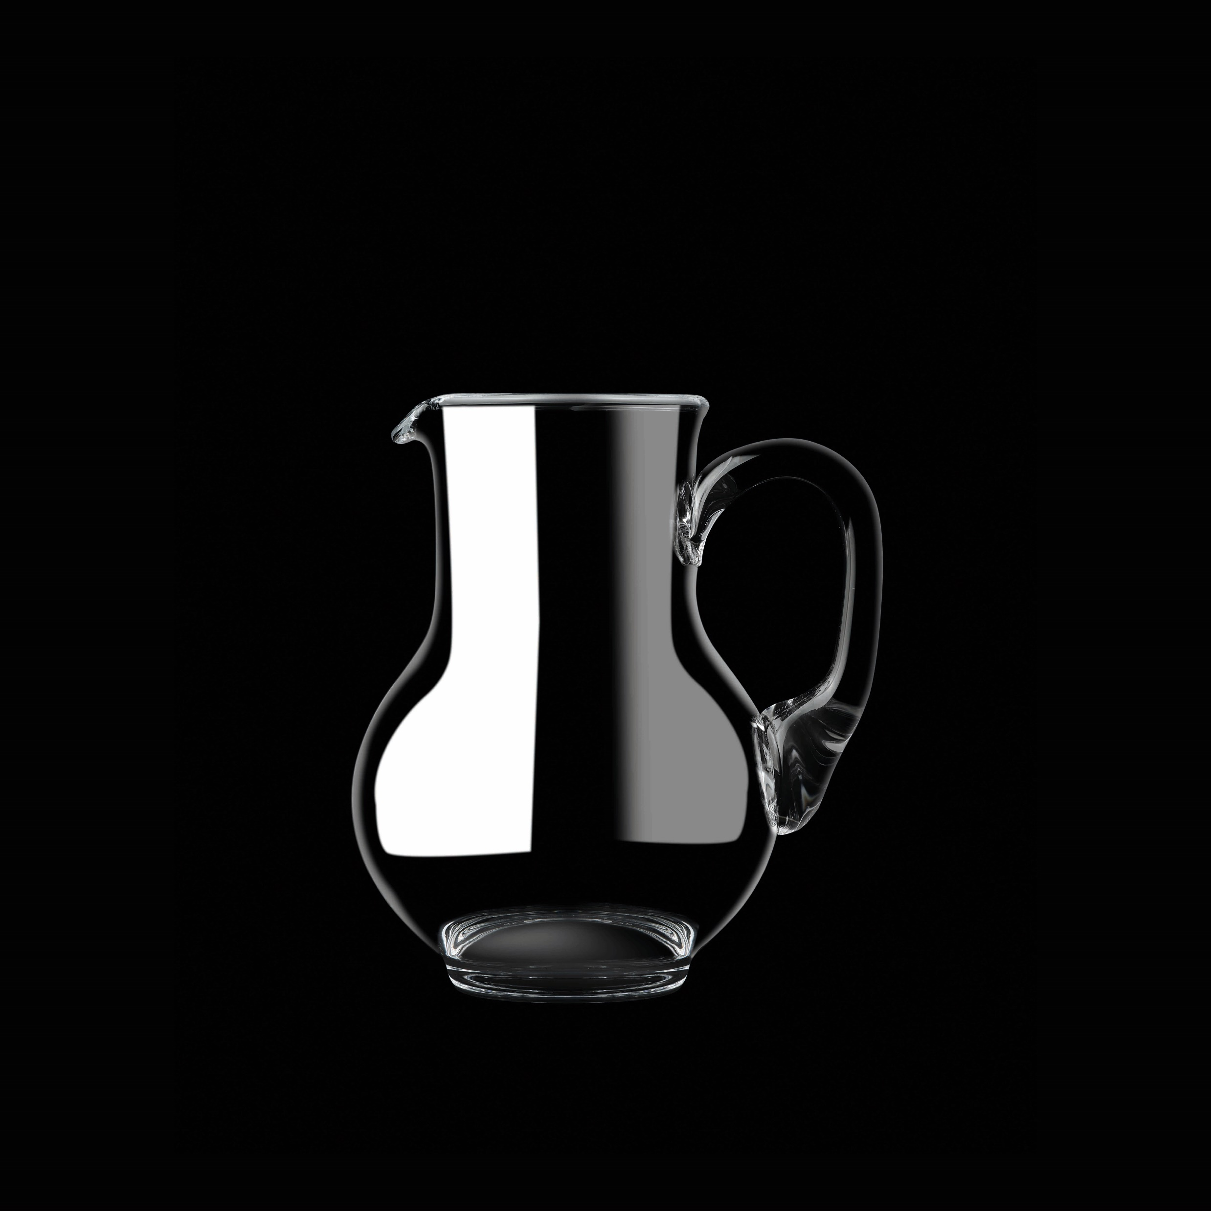
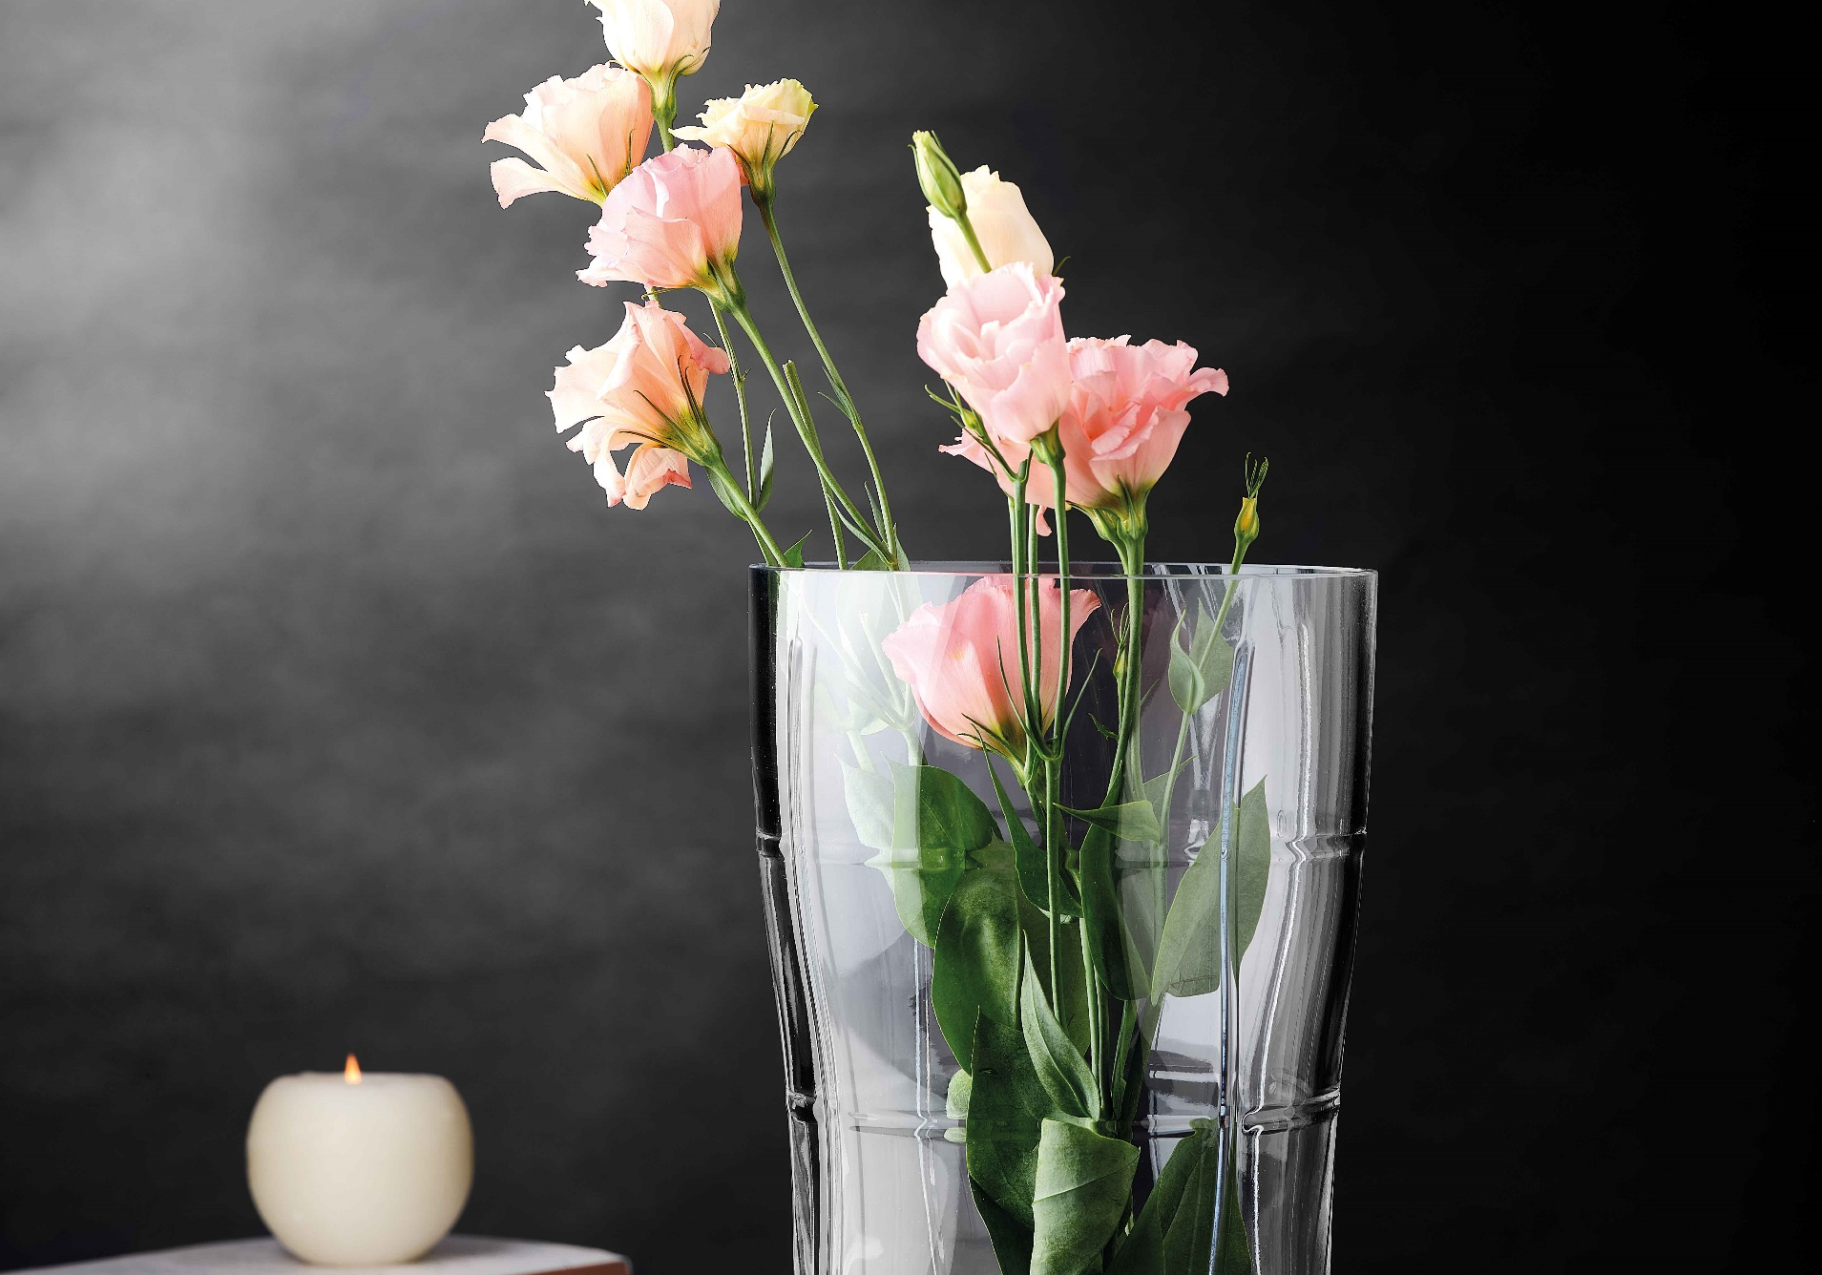
Paşabahçe crystallın
HANDMADE
AQUA
NUDE → PAŞABAHÇE CRYSTALLIN
13144 | 1205102 | Aqua | 1.250
13560 | 163936 | Aqua | 450
13894 | 1098356 | Aqua | 300
23720 | 1041588 | Aqua | 1.500

Slide 8
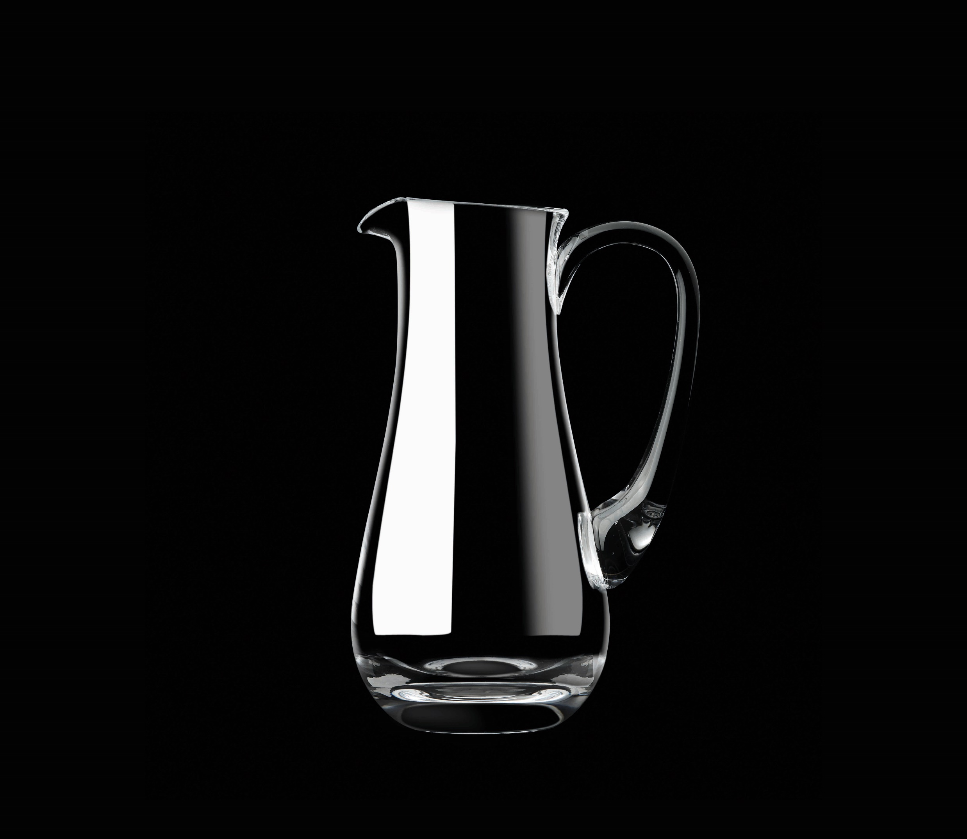
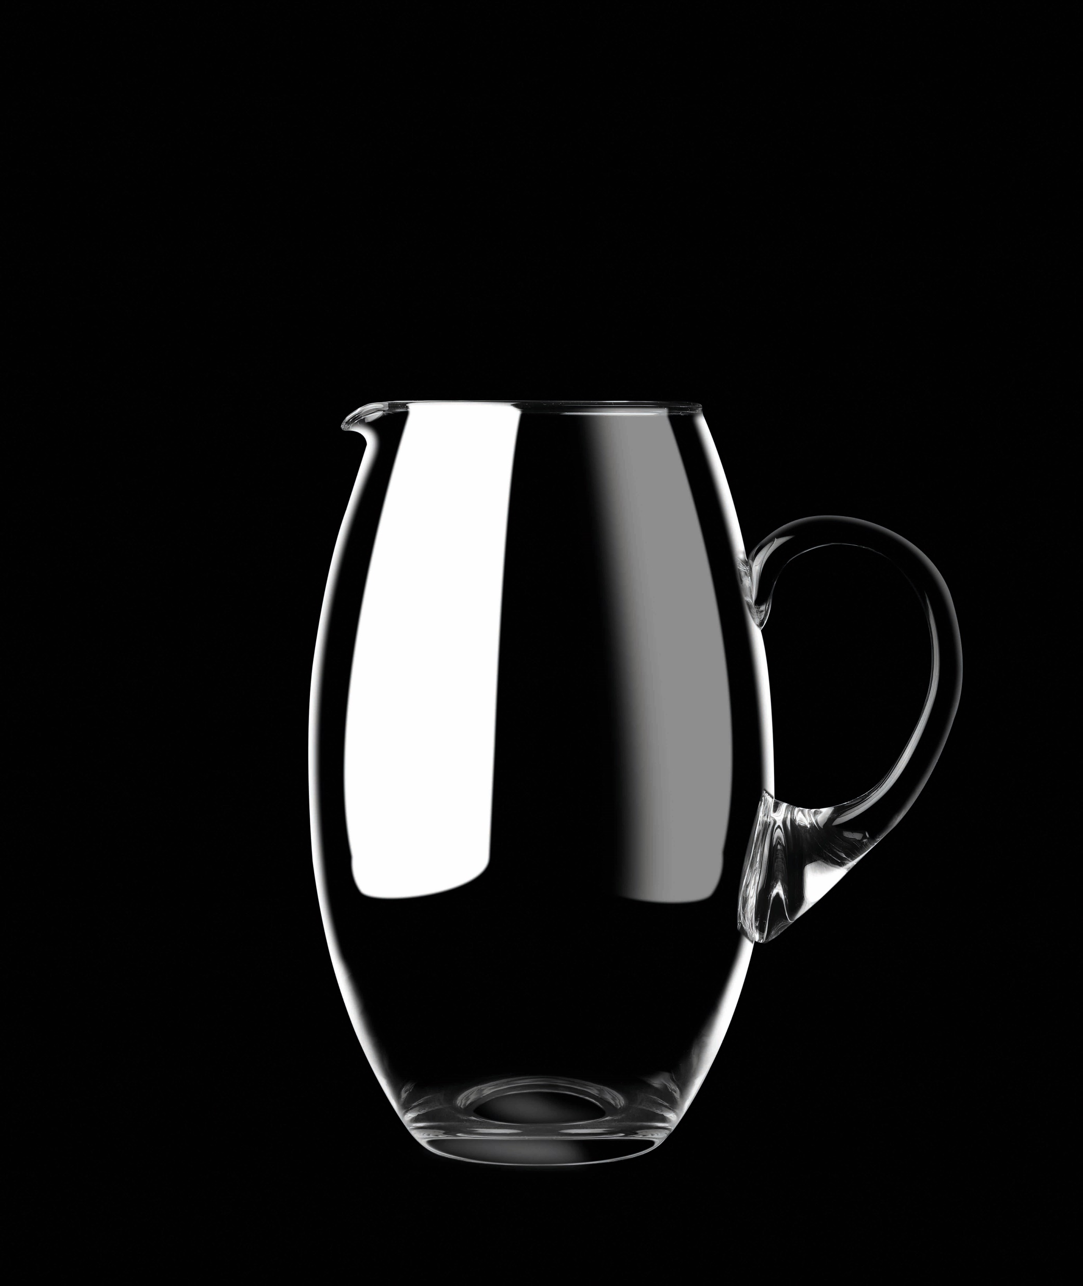
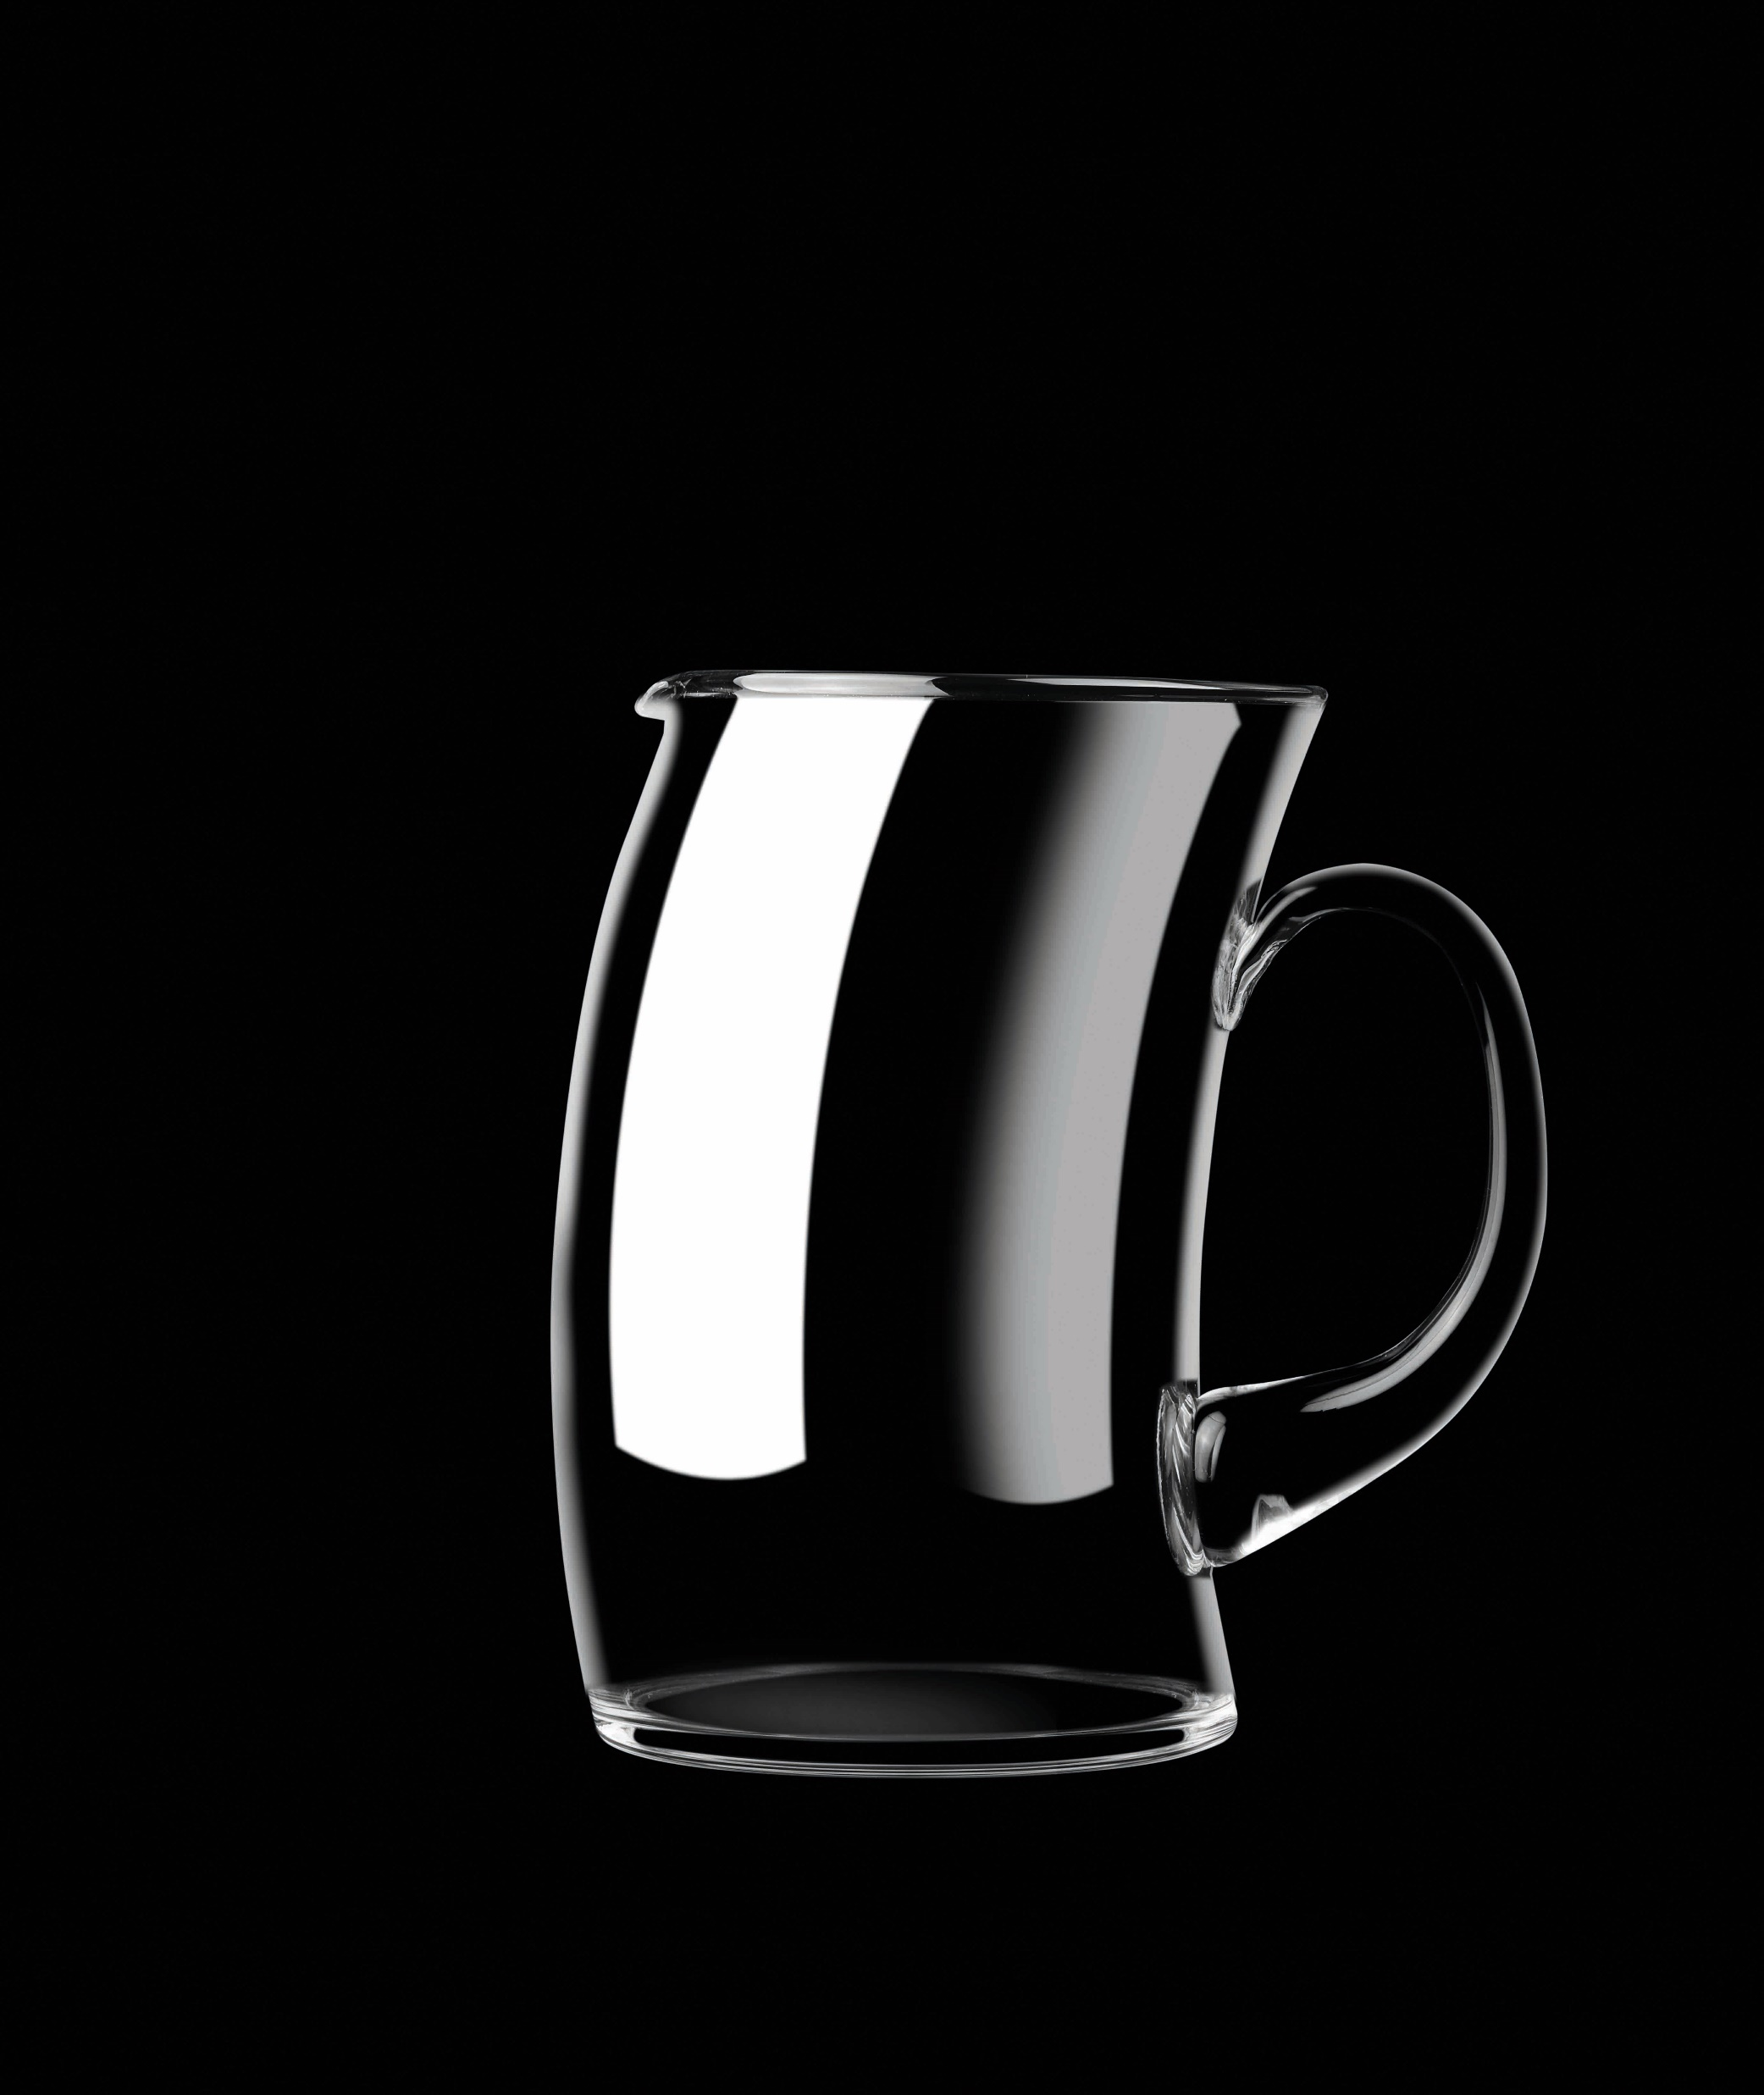

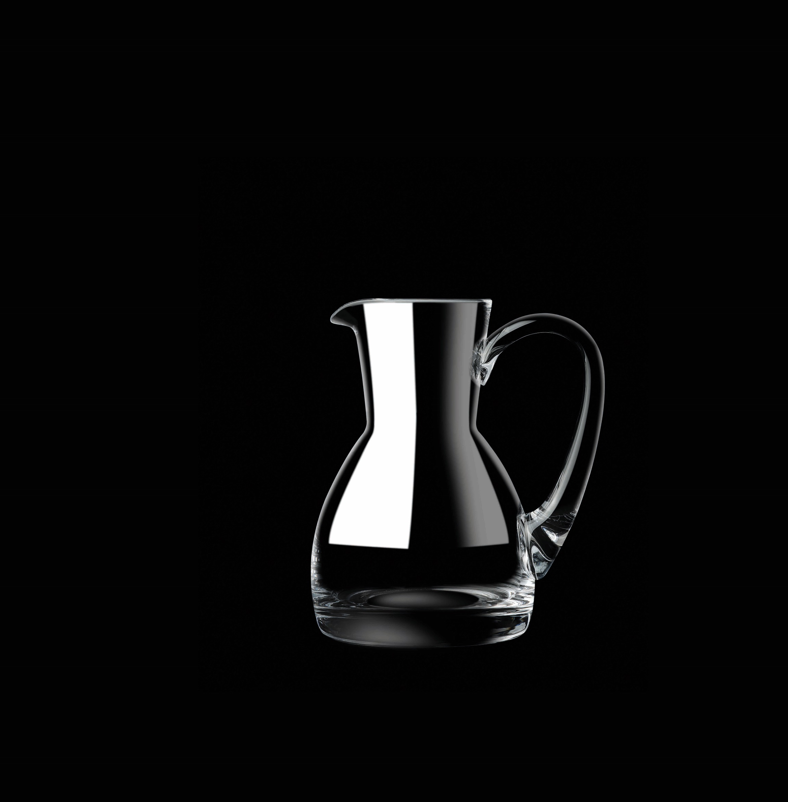
Paşabahçe crystallın handmade
CLARA PUFFY ARROW WINNIE
13124 | 169856 | Clara | 500cc
23719 | 1205149 | Arrow | 1000c
23718 | 1040587 | Puffy | 2400cc
18803 | 107300 | Winnie | 350cc
19344 | 204752 | Winnie | 350cc

Slide 9
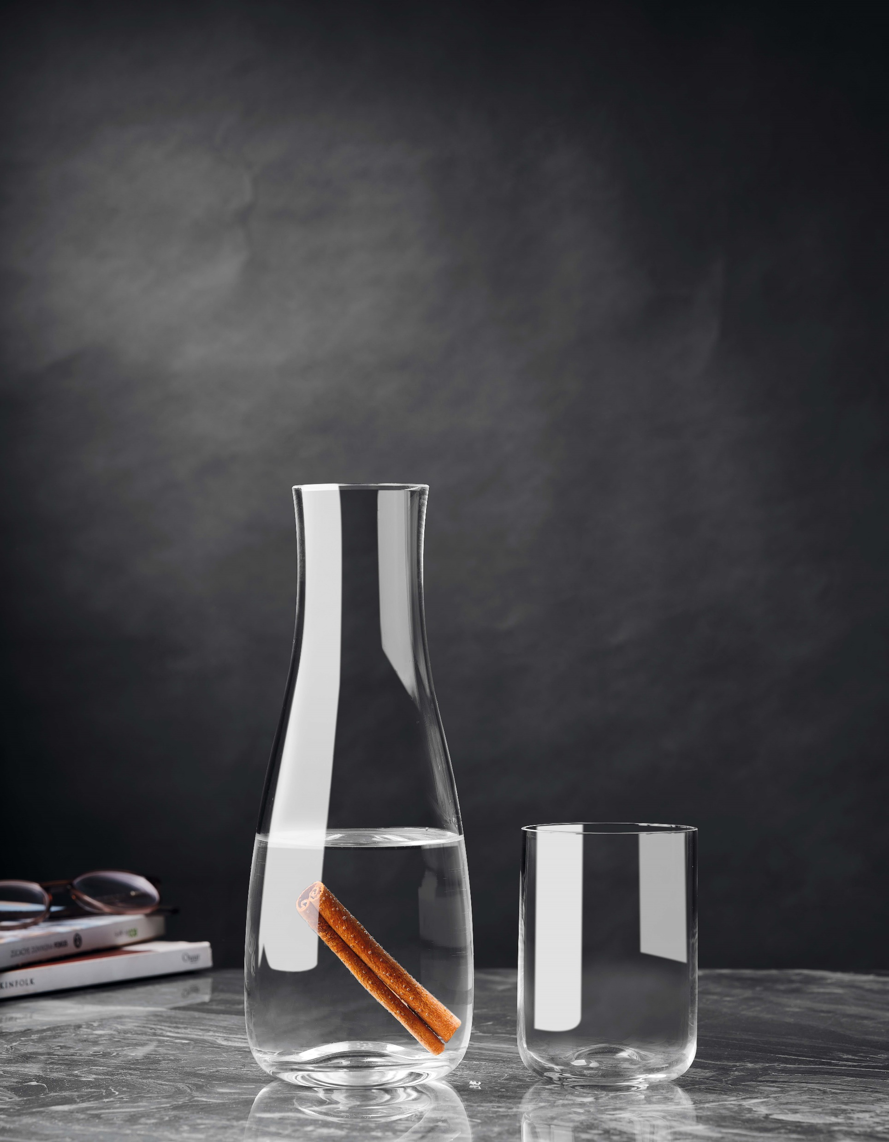

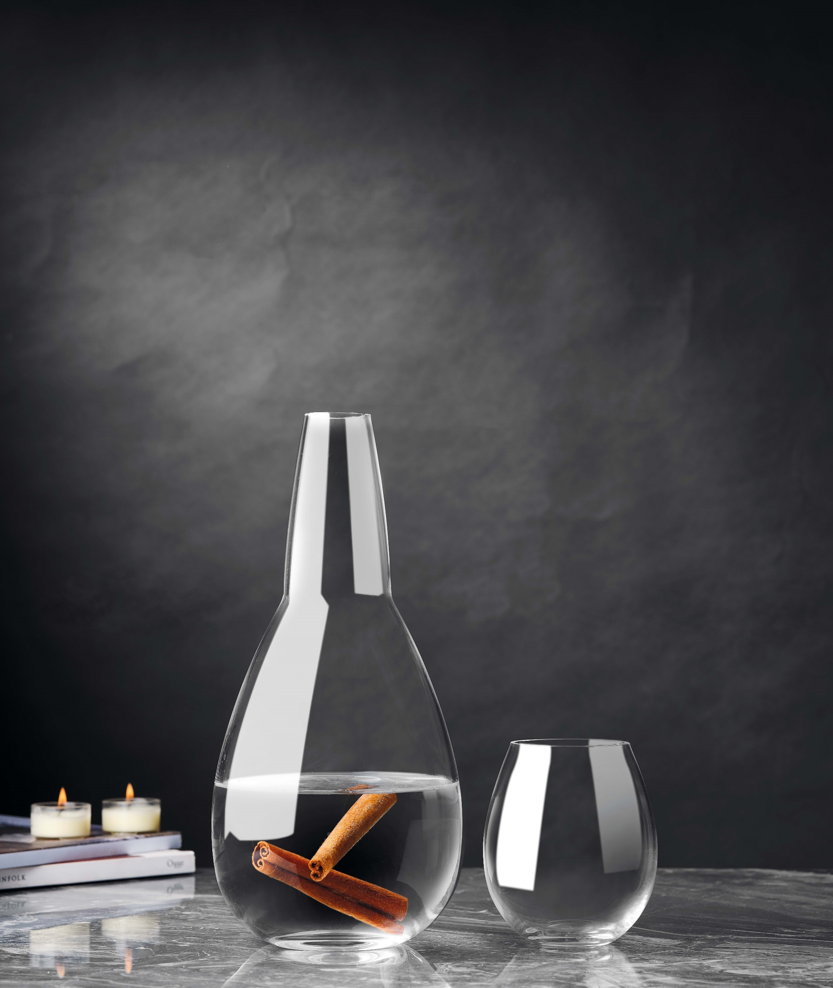

Paşabahçe crystallın handmade
COCO LEO FREYA
92218 | 1041439 | Coco | 1000cc
92657 | 1082656 | Leo | 900cc
91209 | 1015950 | Freya | 1500cc

Slide 10
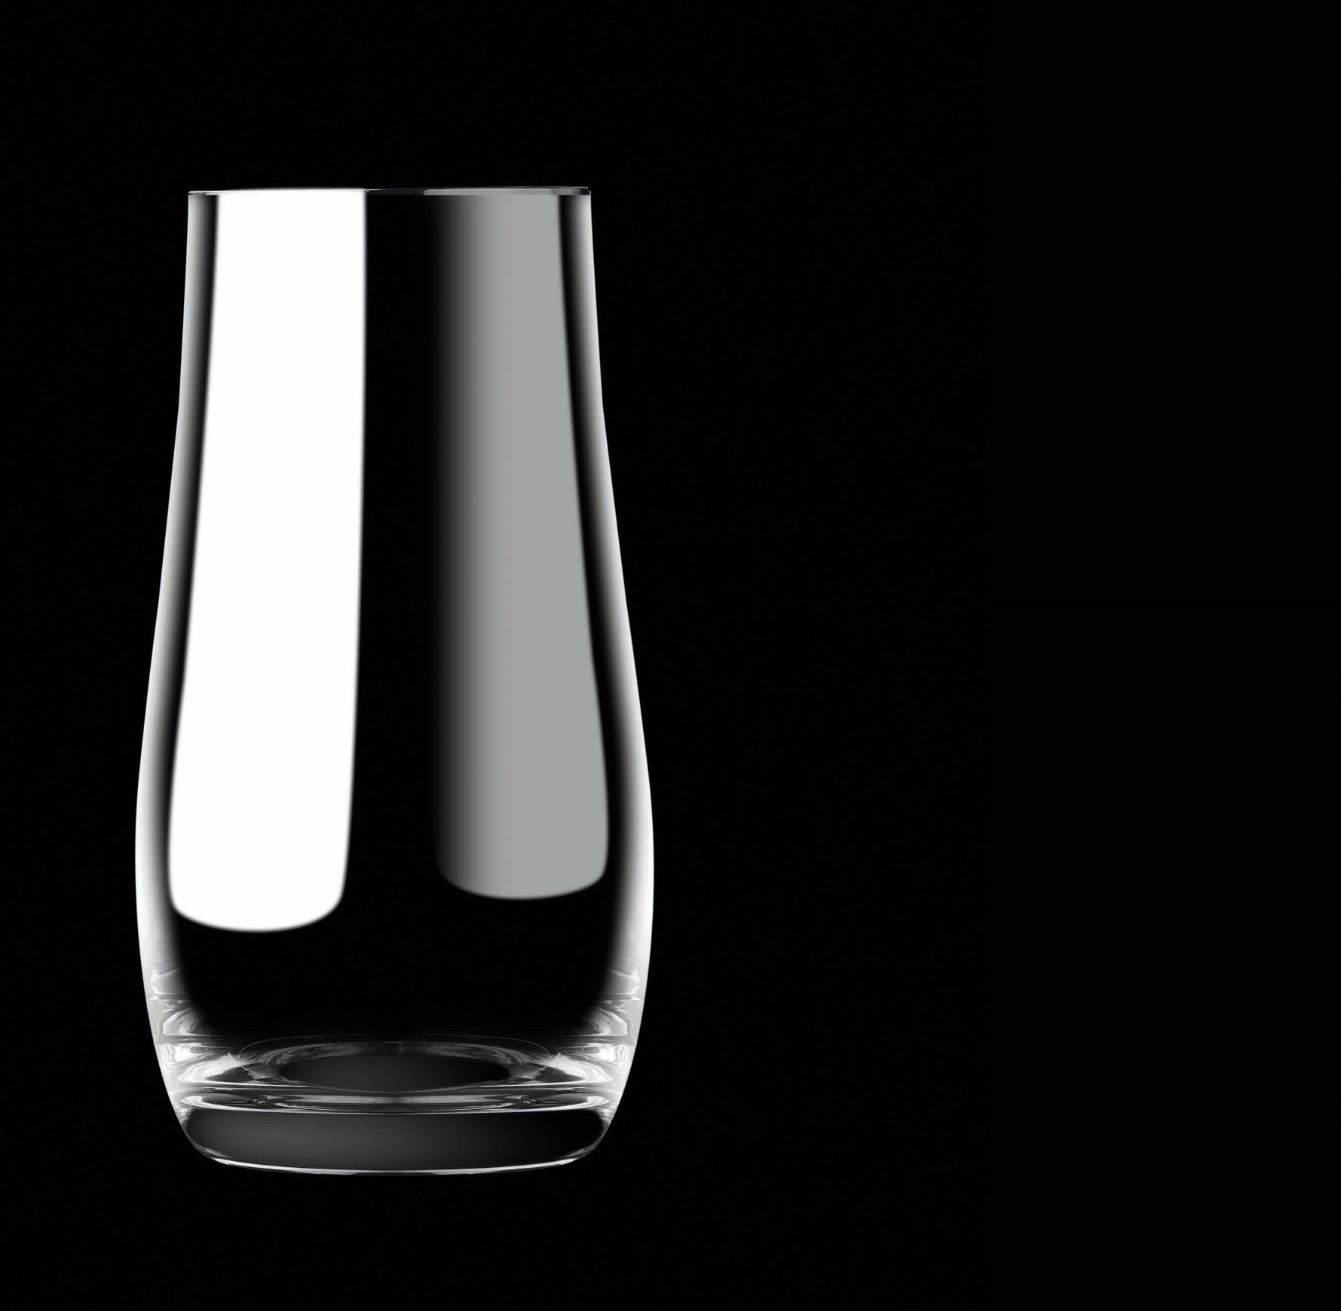
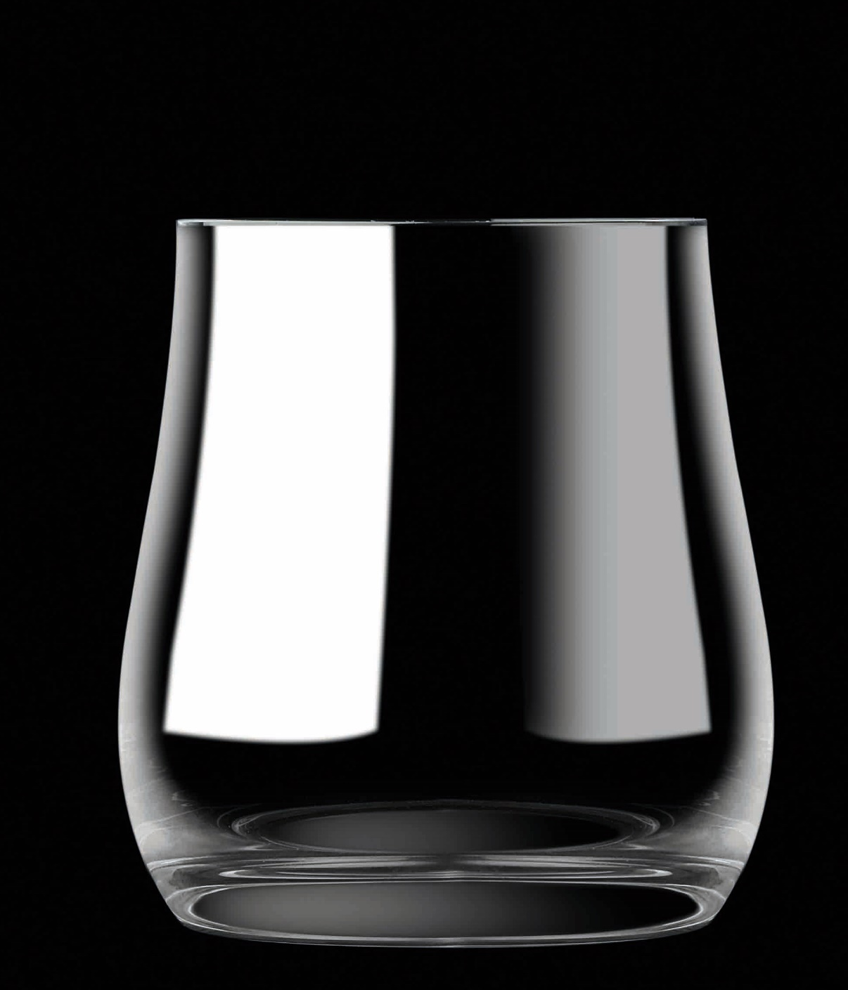
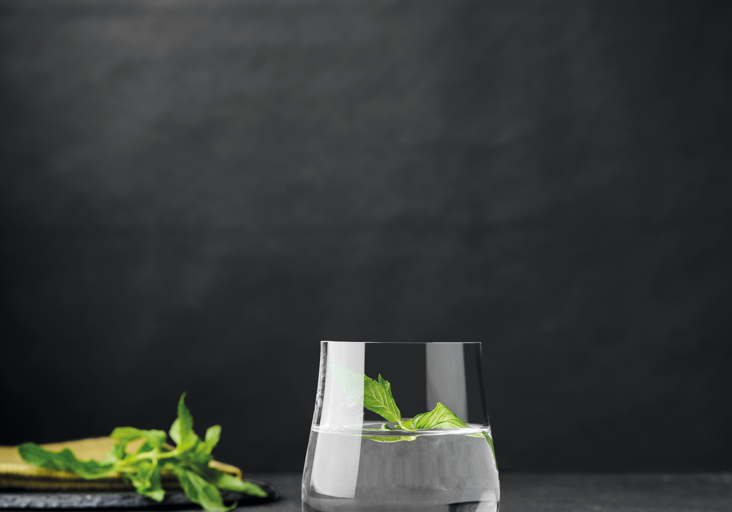
Paşabahçe crystallın handmade
22708 | 1205135 | Drop | 342 cc
22709 | 1205136 | Drop | 467 cc
DROP

Slide 11
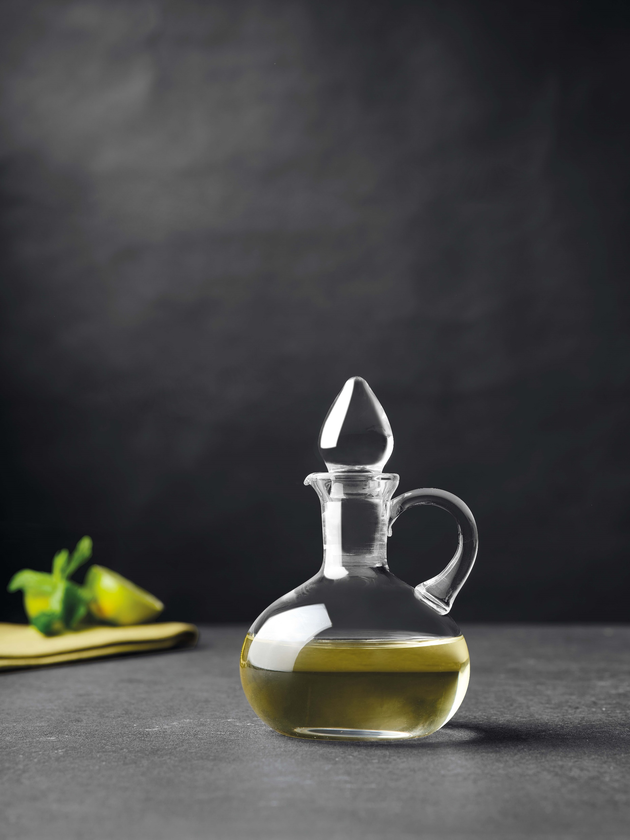
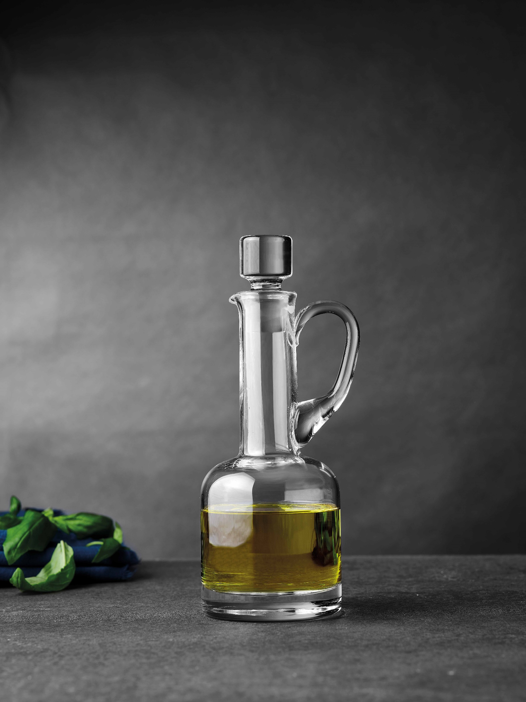
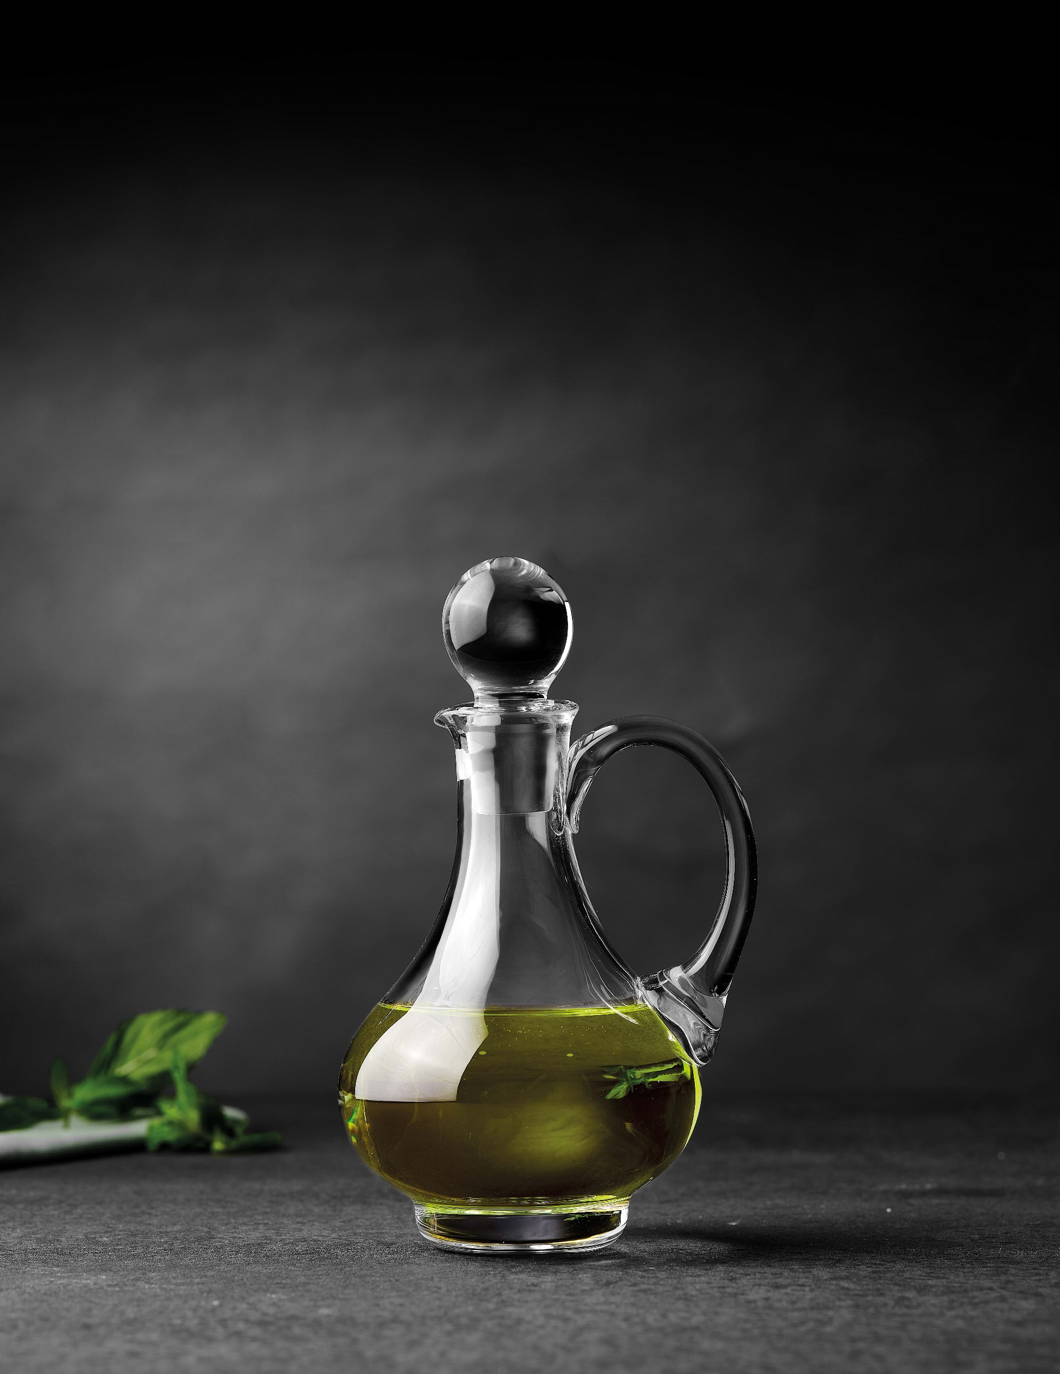

Paşabahçe crystallın handmade
DUFY
90158 | 1019053 | Dufy | 260
90177 | 1084057 | Dufy | 300
90690 | 1098329 | Dufy | 250

Slide 12
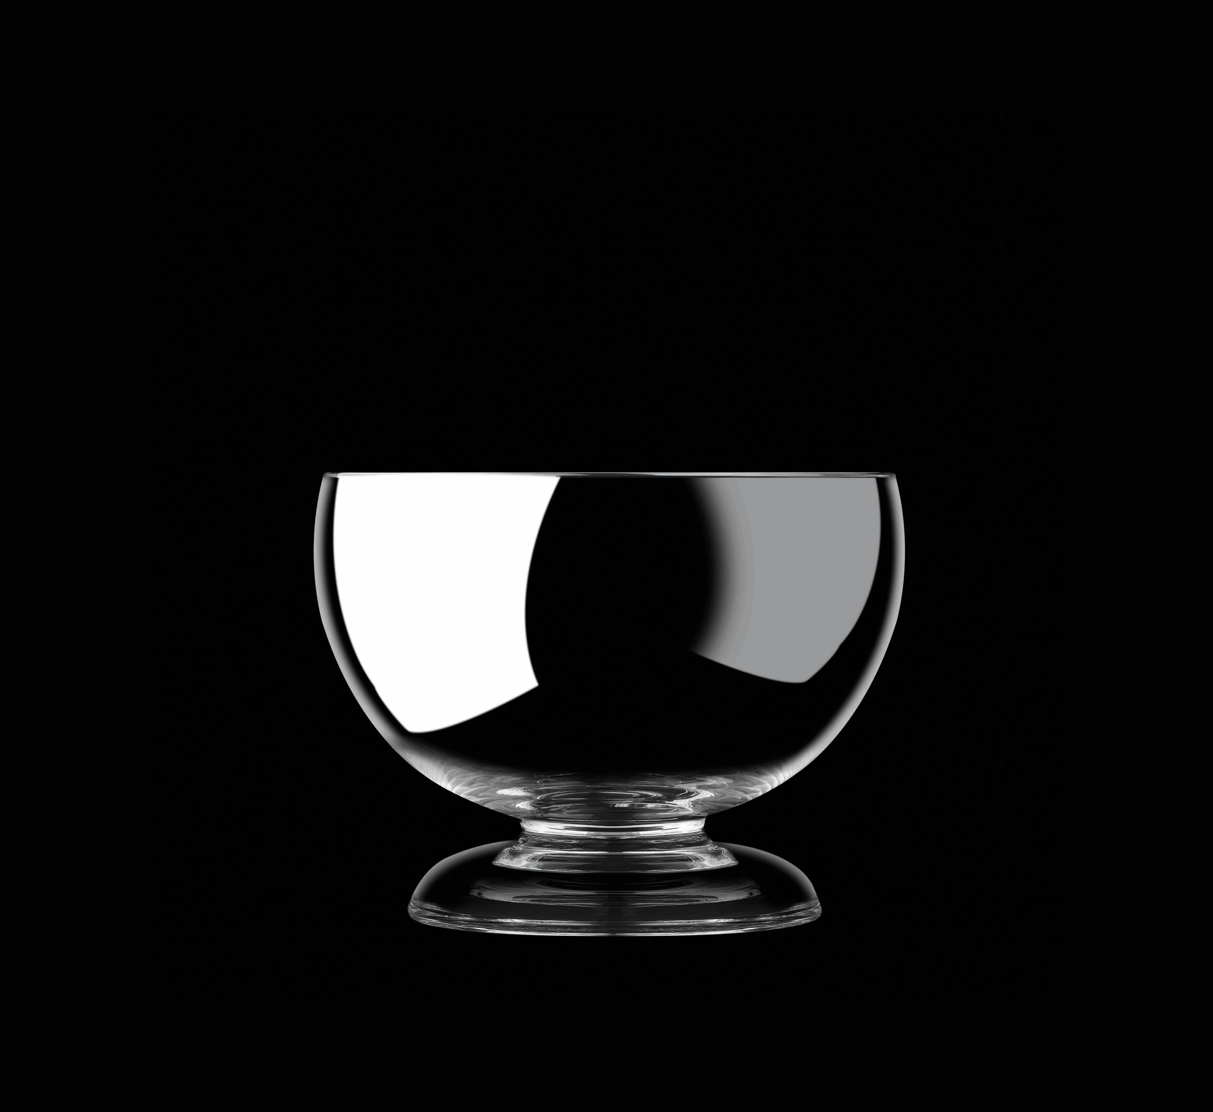
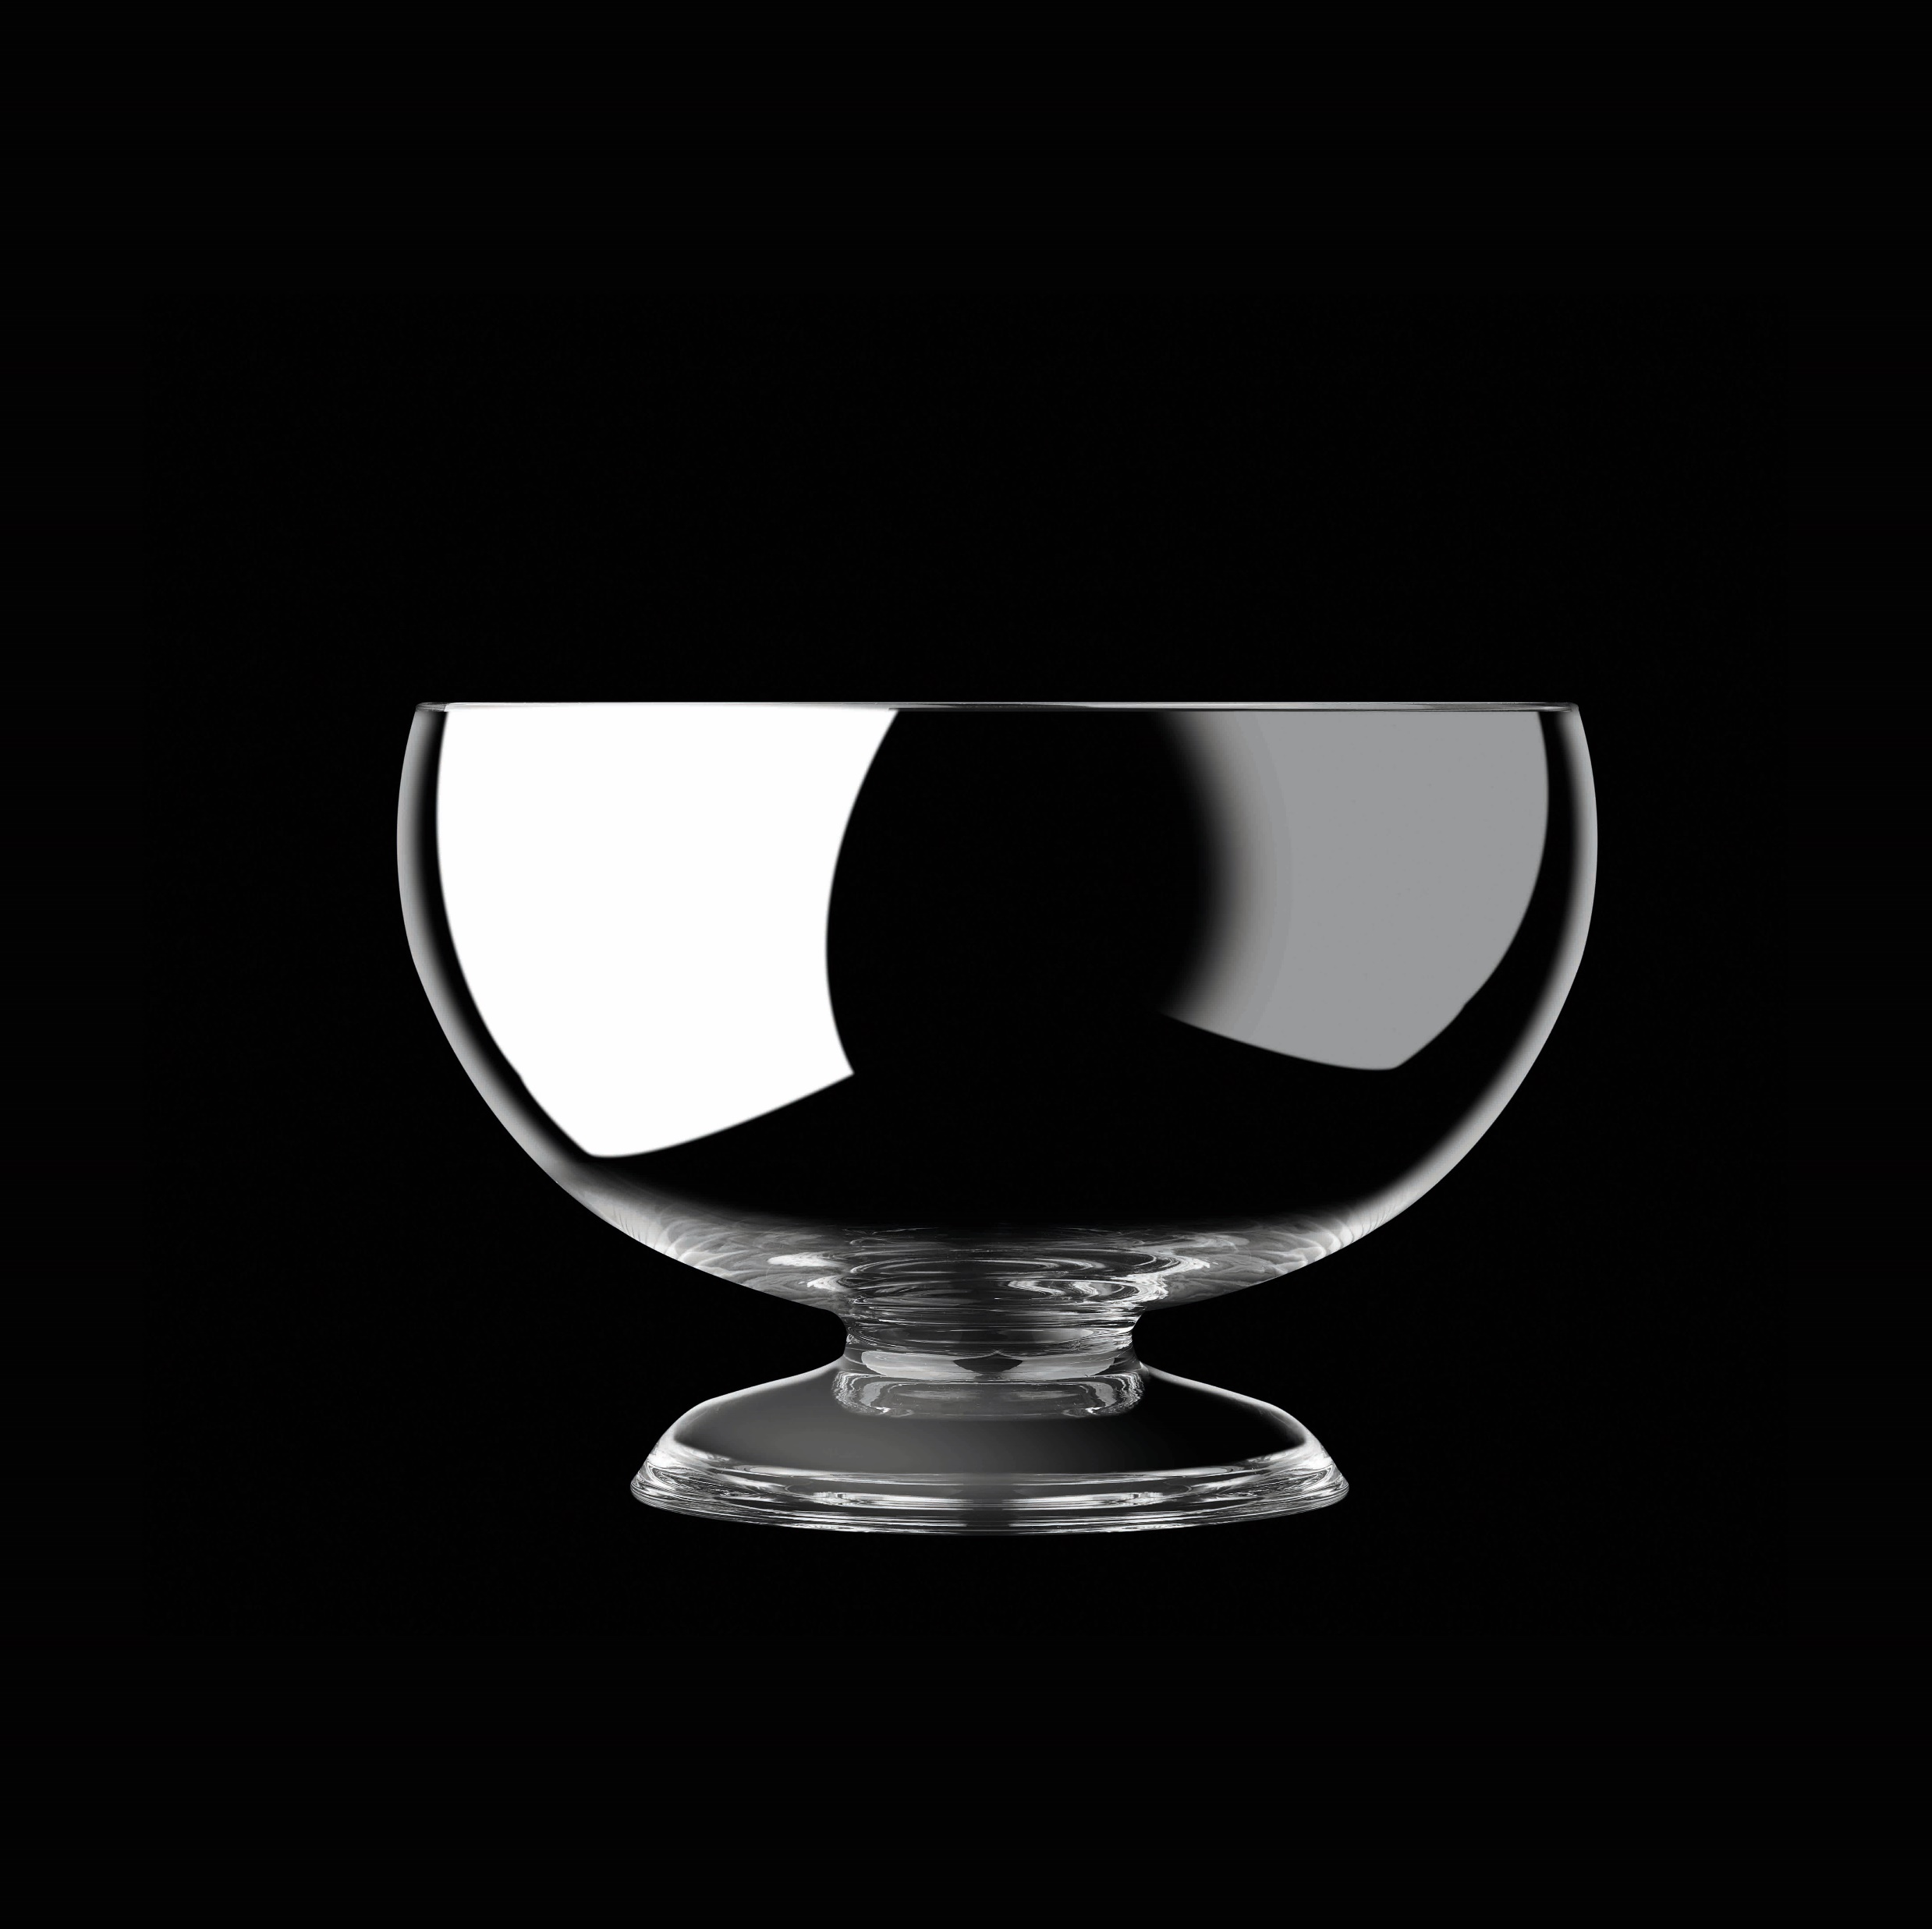
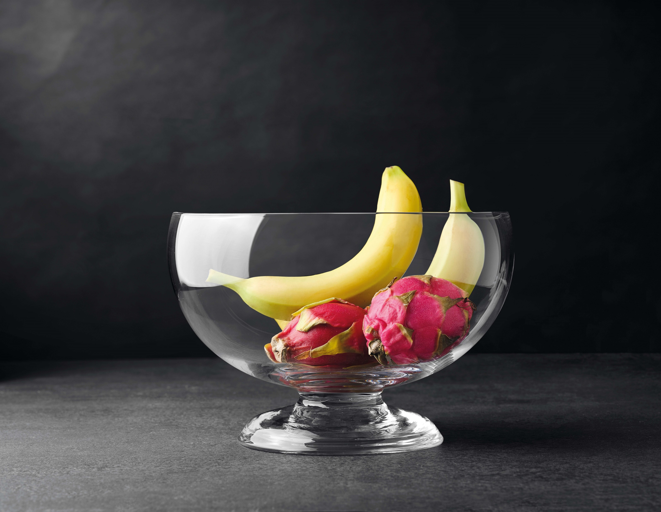
Paşabahçe crystallın handmade
BETTY
31781 | 1033739 | Betty | 200X270mm
31796 | 1205115 | Betty | 240X148mm
Сток в ноябре

Slide 13
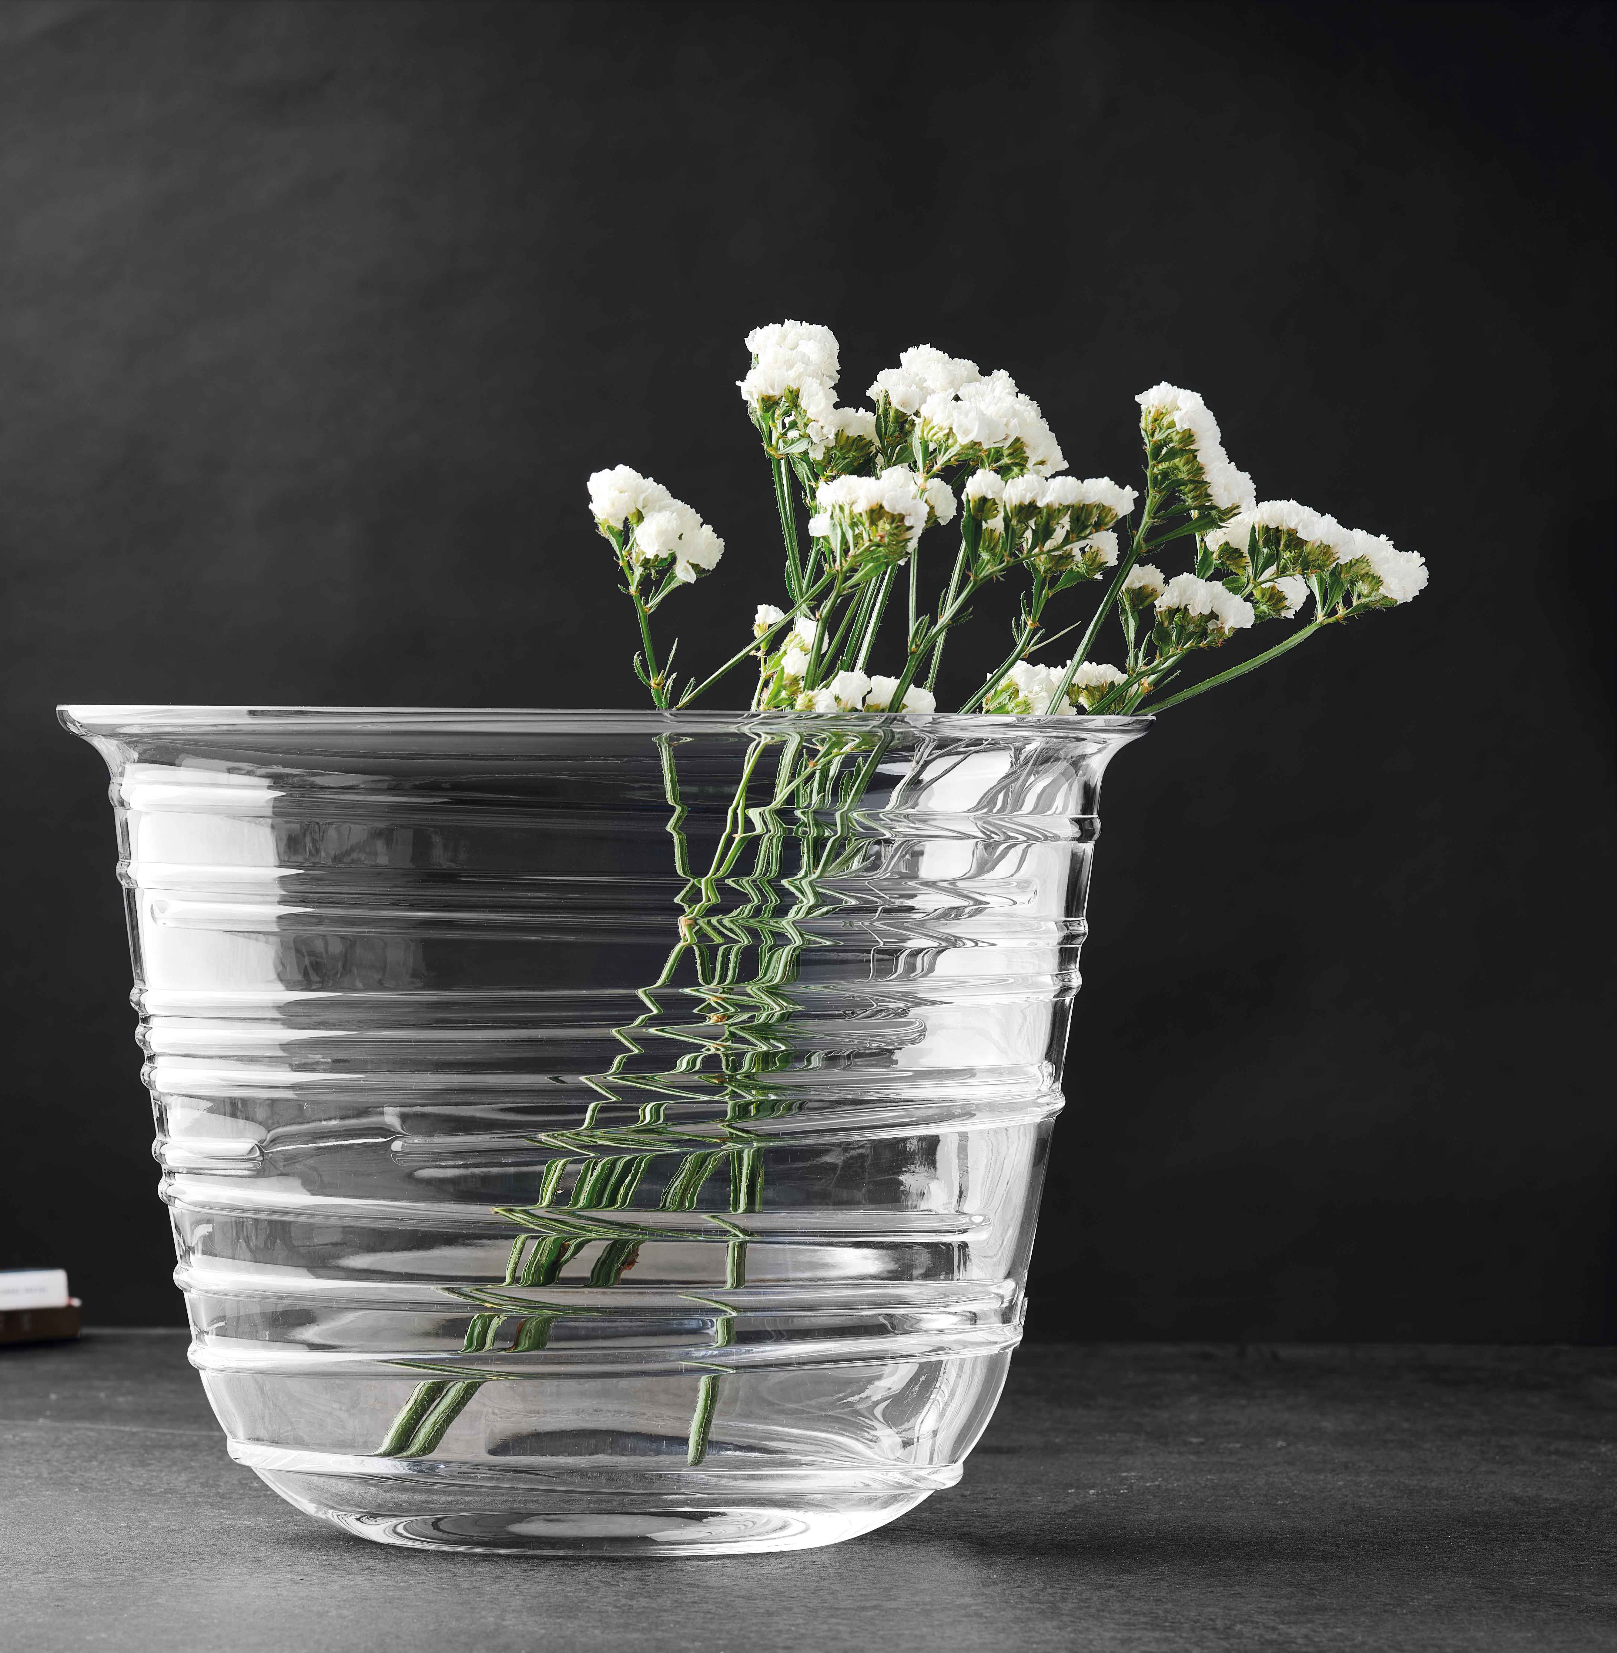


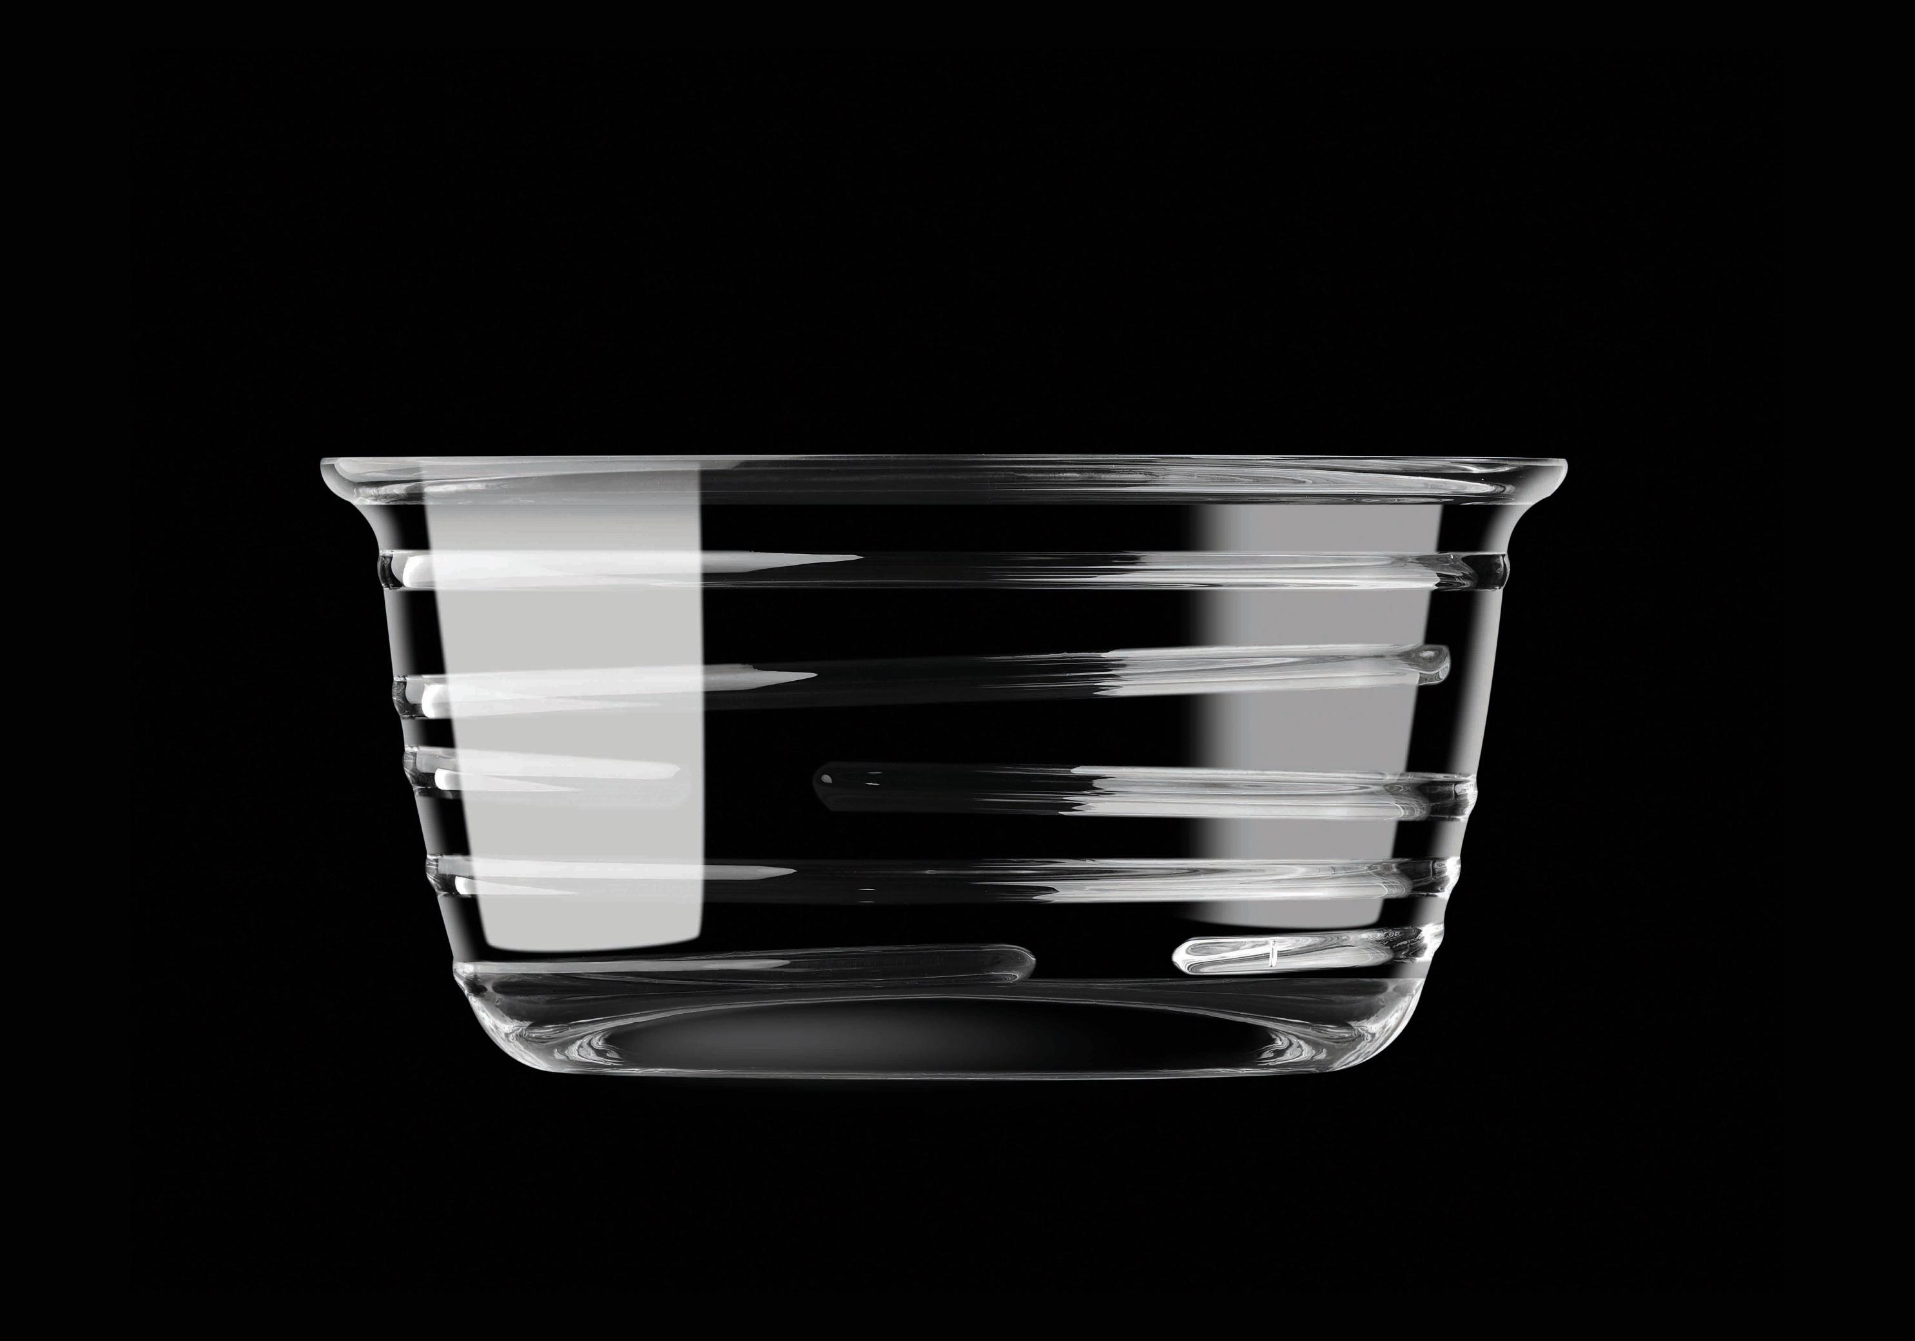
Paşabahçe crystallın handmade
ESCAPE
23430 | 1205106 | Escape |  | 550
23554 | 1205111 | Escape |  | 320
23555 | 1205112 | Escape |  | 300

Slide 14

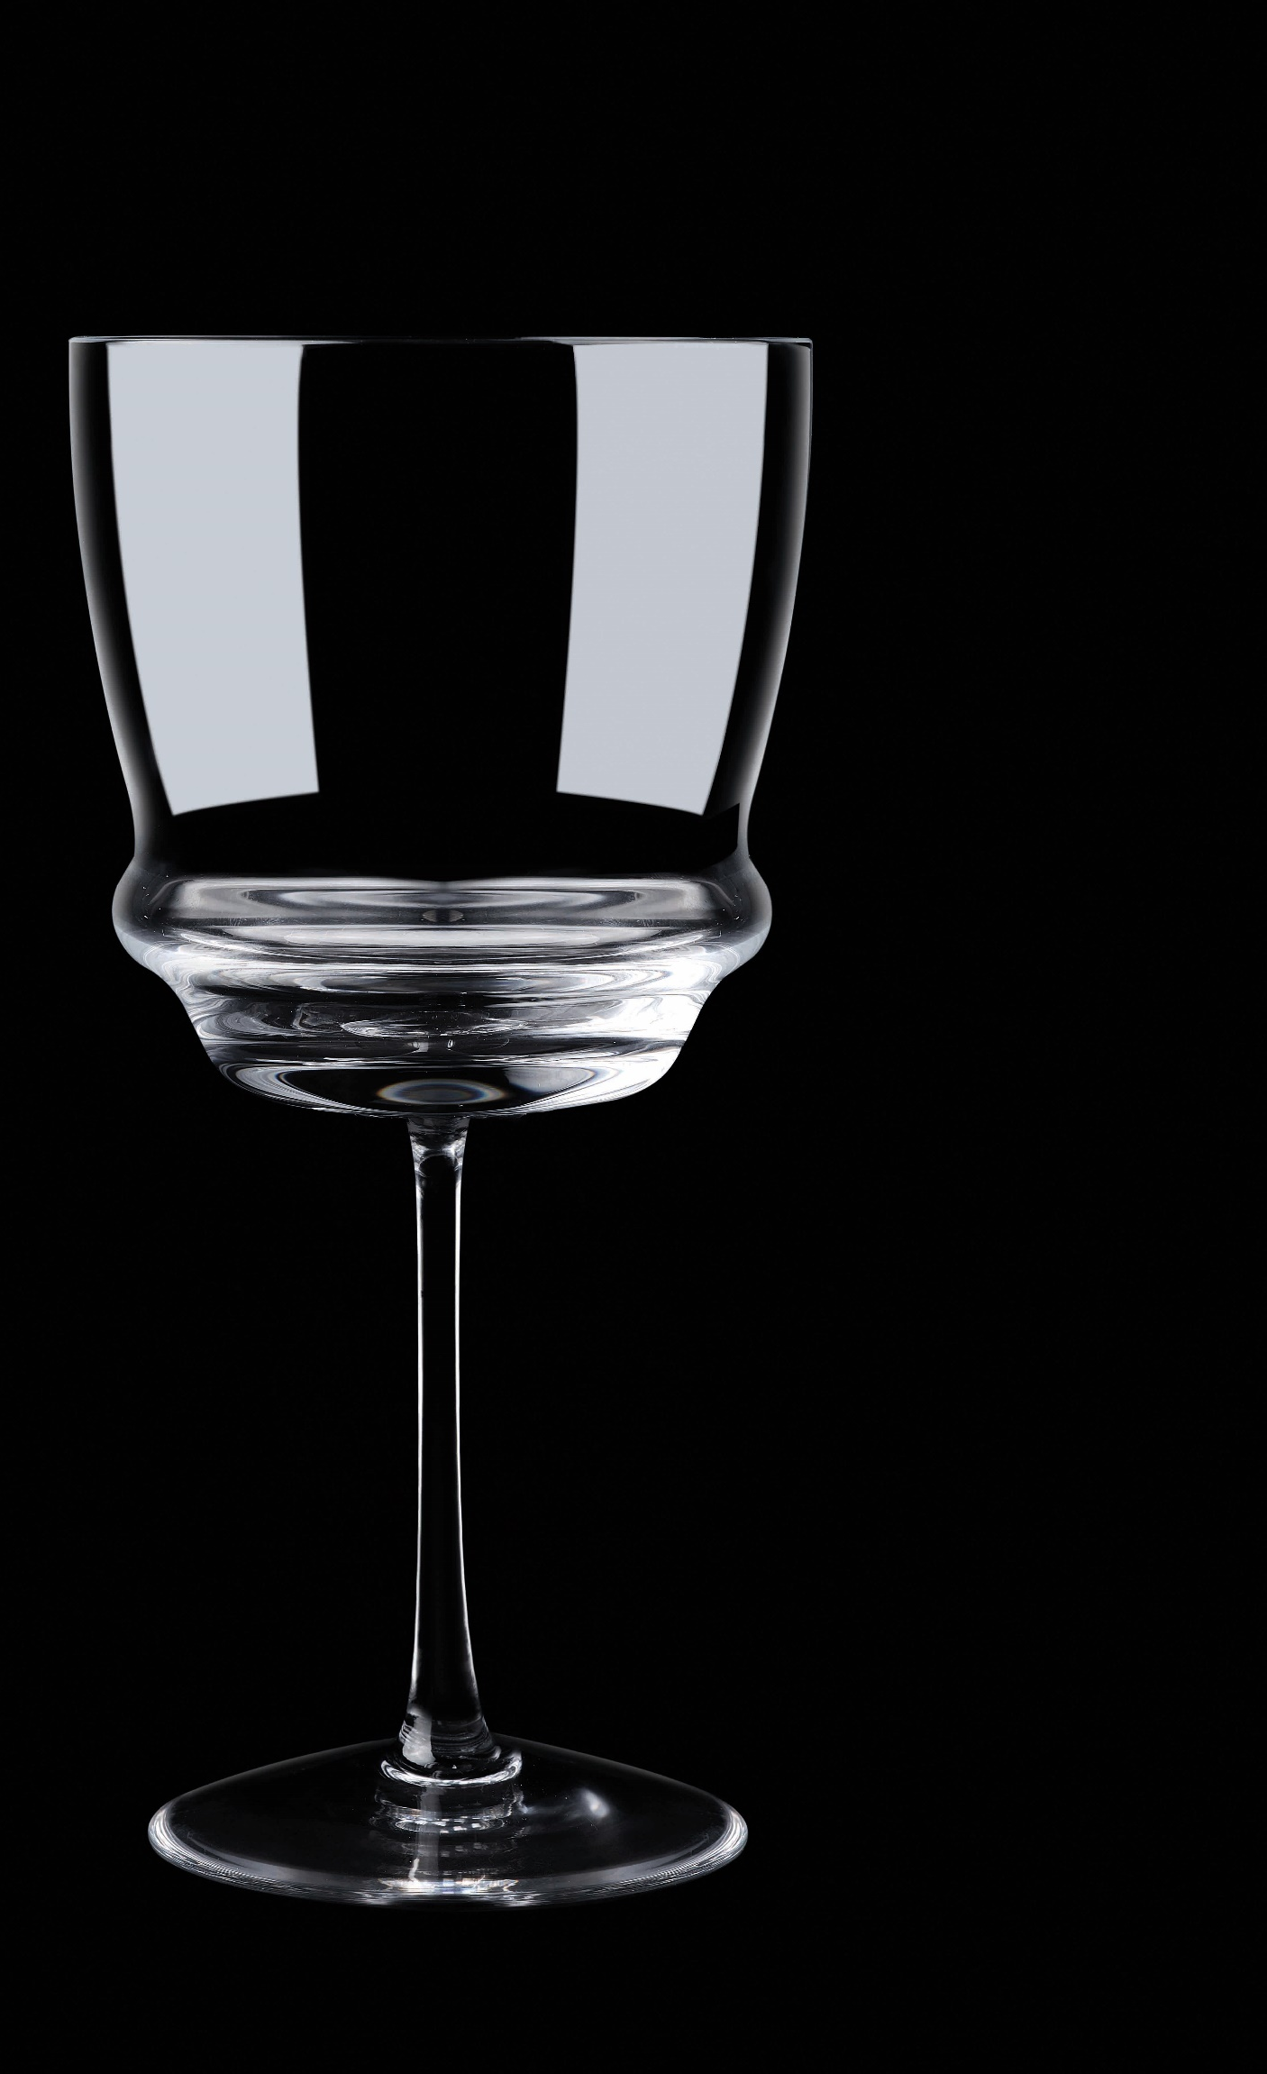

Paşabahçe crystallın handmade
VINO FLOKI
20888 | 1098293 | Vino | 1700cc
32302 | 1205116 | Floki | 230cc
32303 | 1205118 | Floki | 490cc

Slide 15
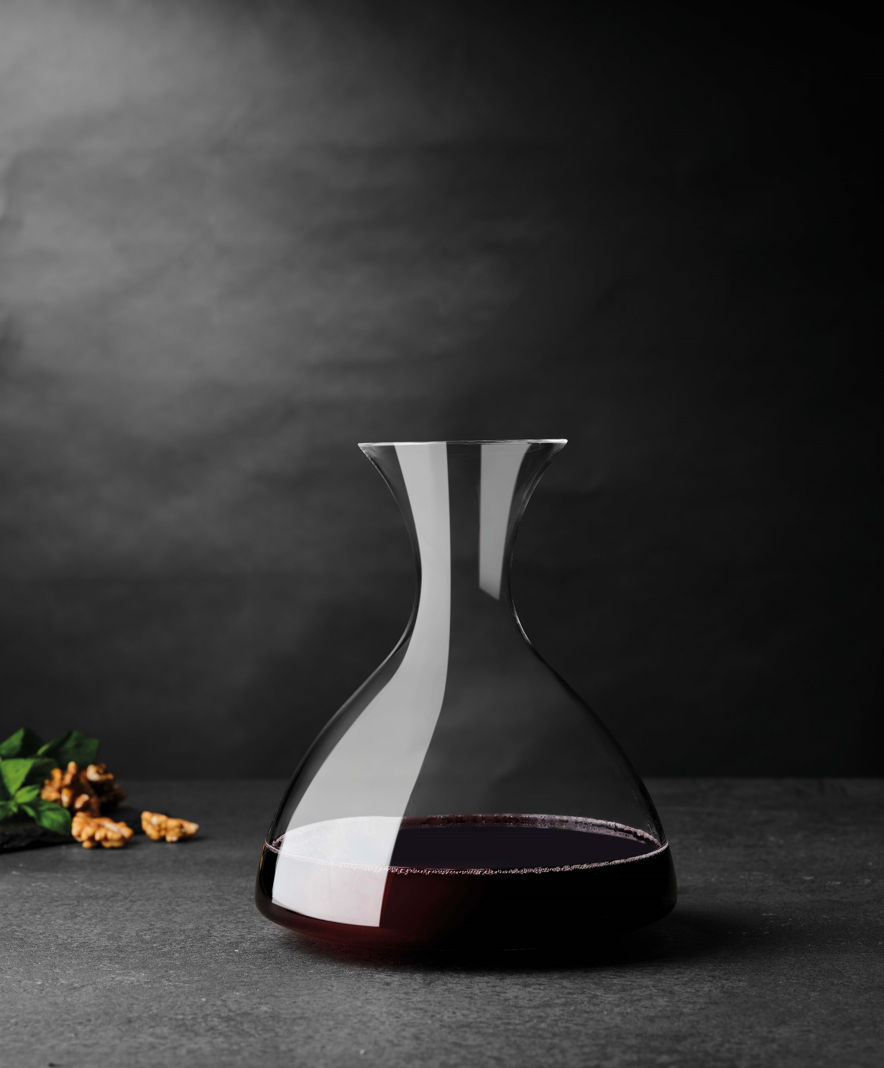
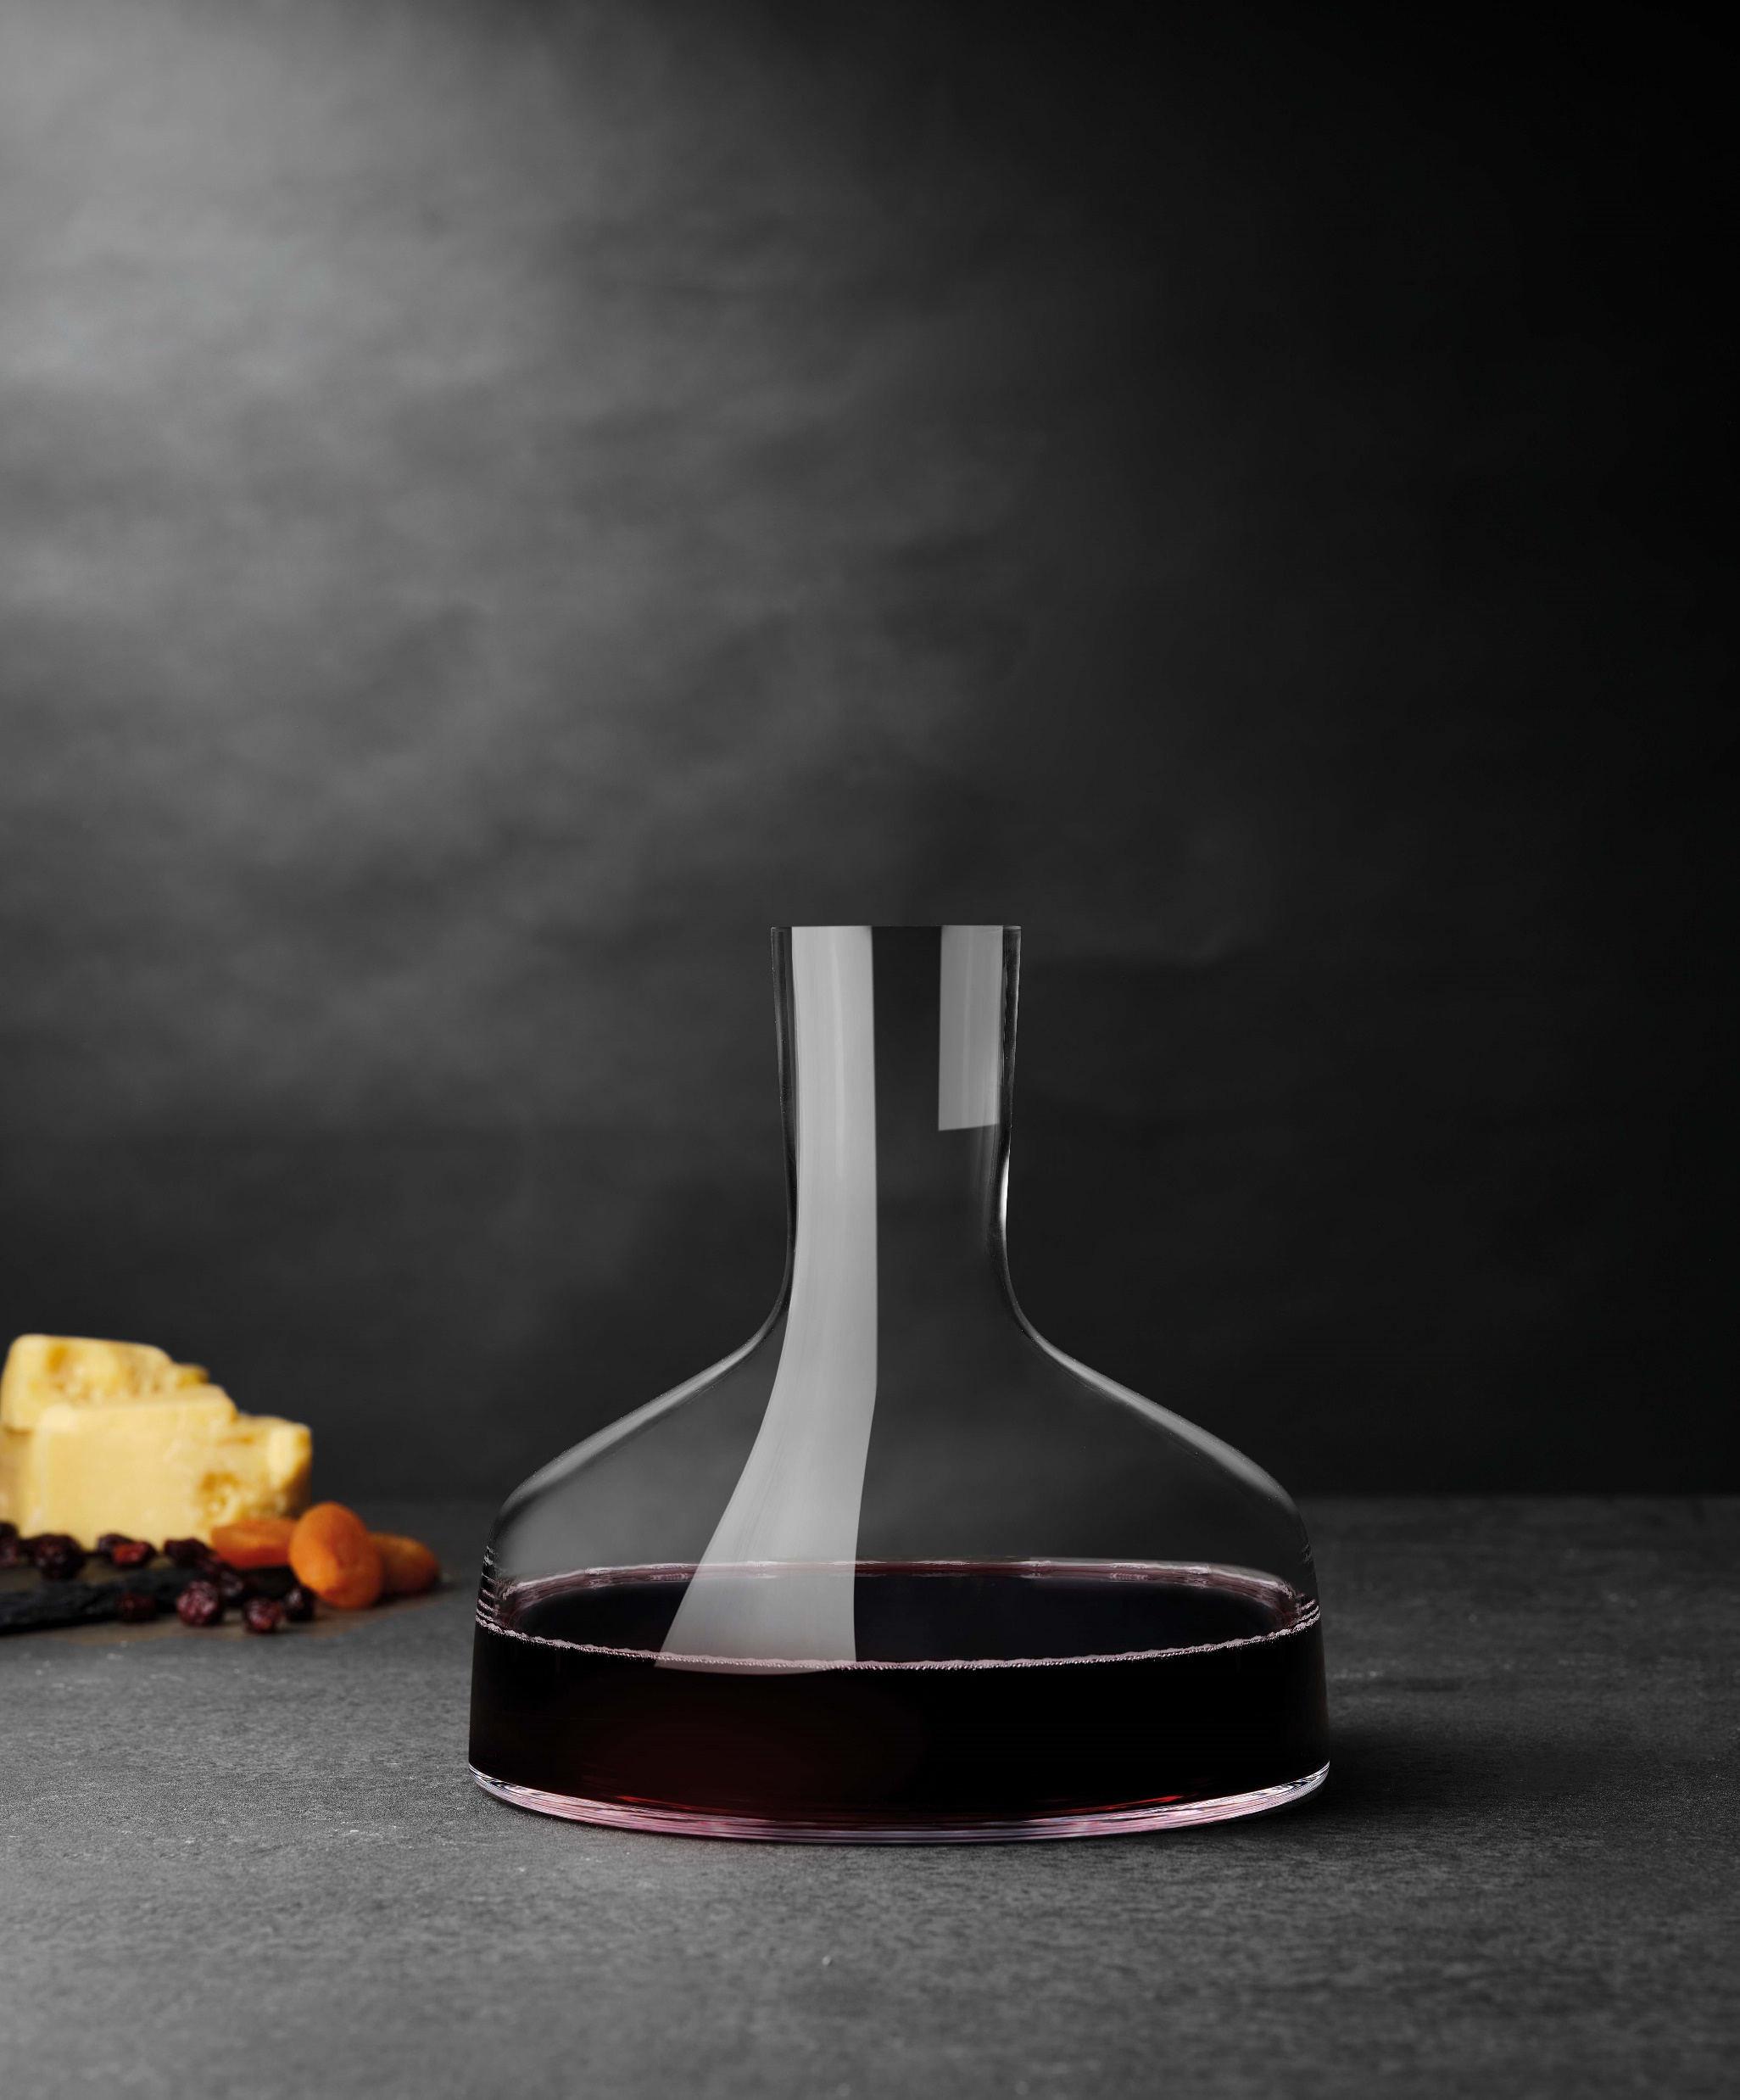
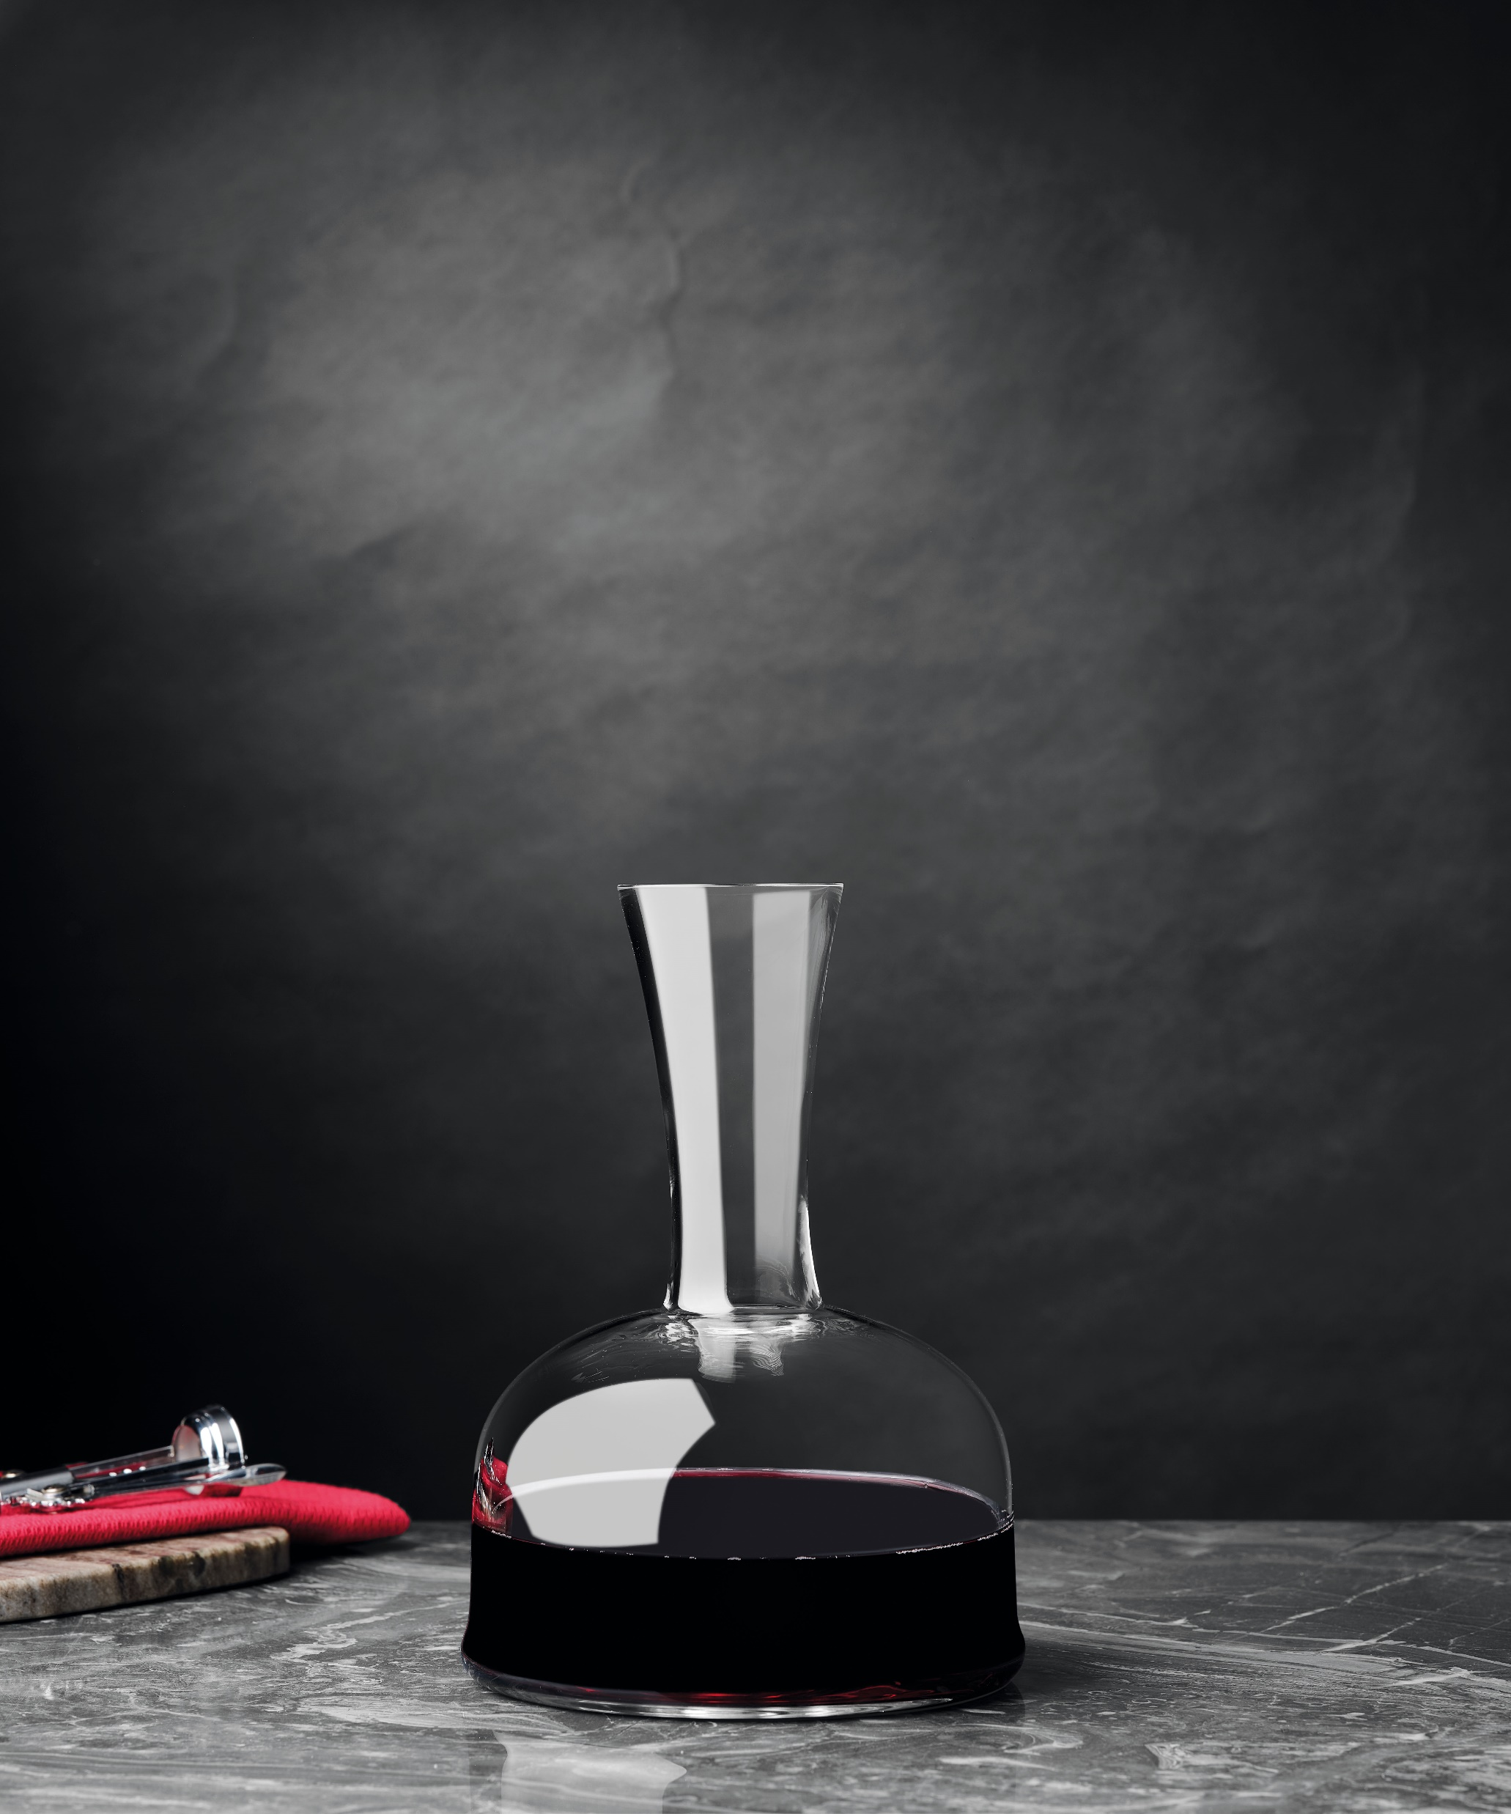

Paşabahçe crystallın handmade
VINTAGE OLDEN HELM
20254 | 625512 | Vintage | 750cc
13635 | 1055707 | Olden | 1500 cc
18678 | 1205104 | Helm | 1500cc

Slide 16
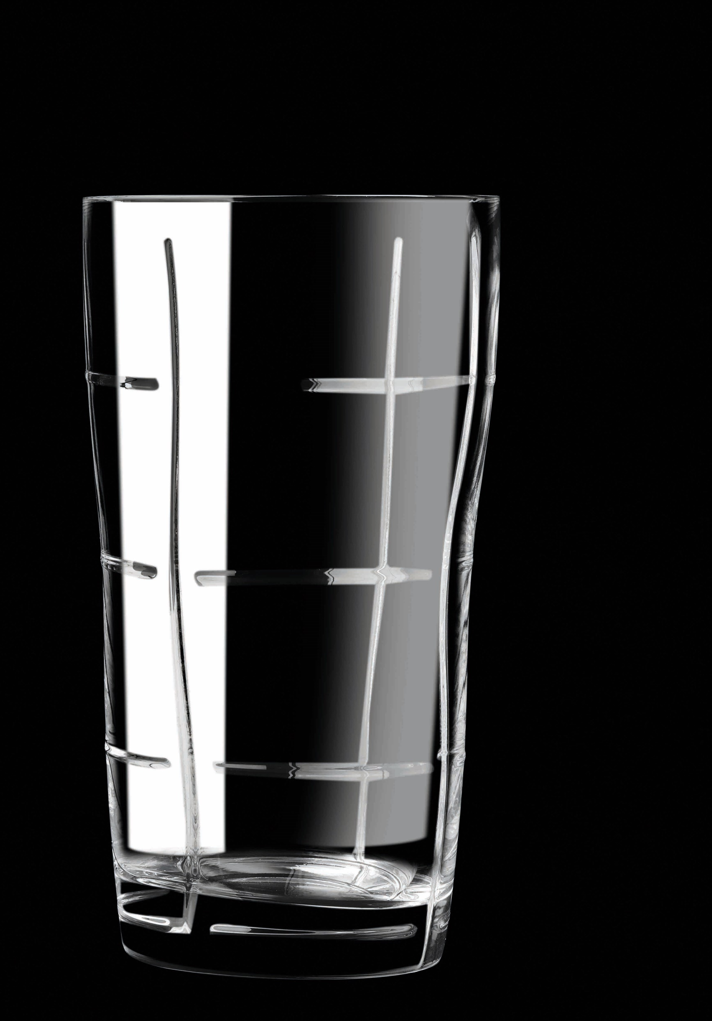
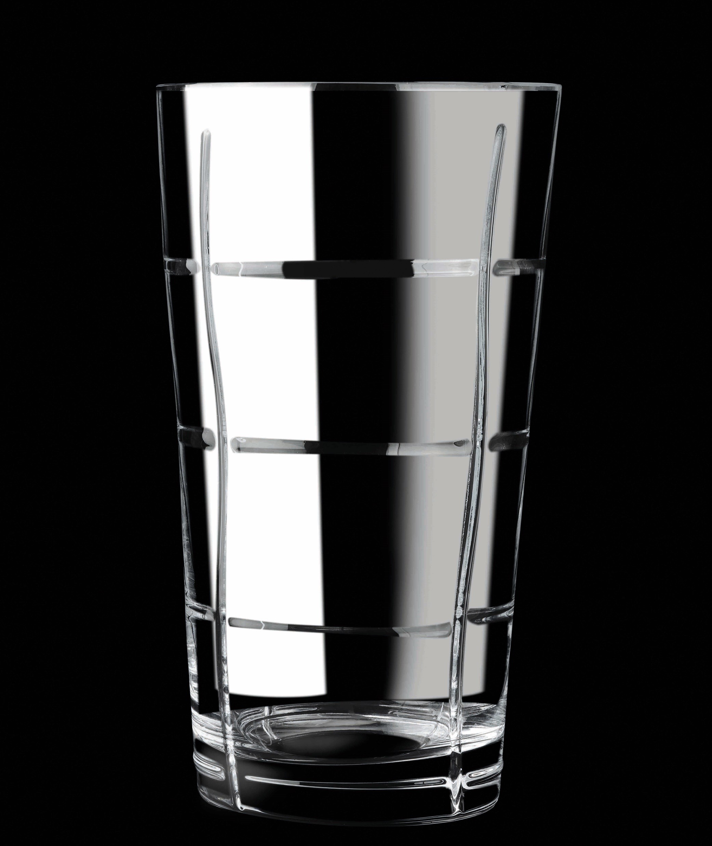
Paşabahçe crystallın handmade
23523 | 1019624 | Wireframe | 280mm
23524 | 1205107 | Wireframe | 220mm
Сток в ноябре
WIREFRAME

Slide 17
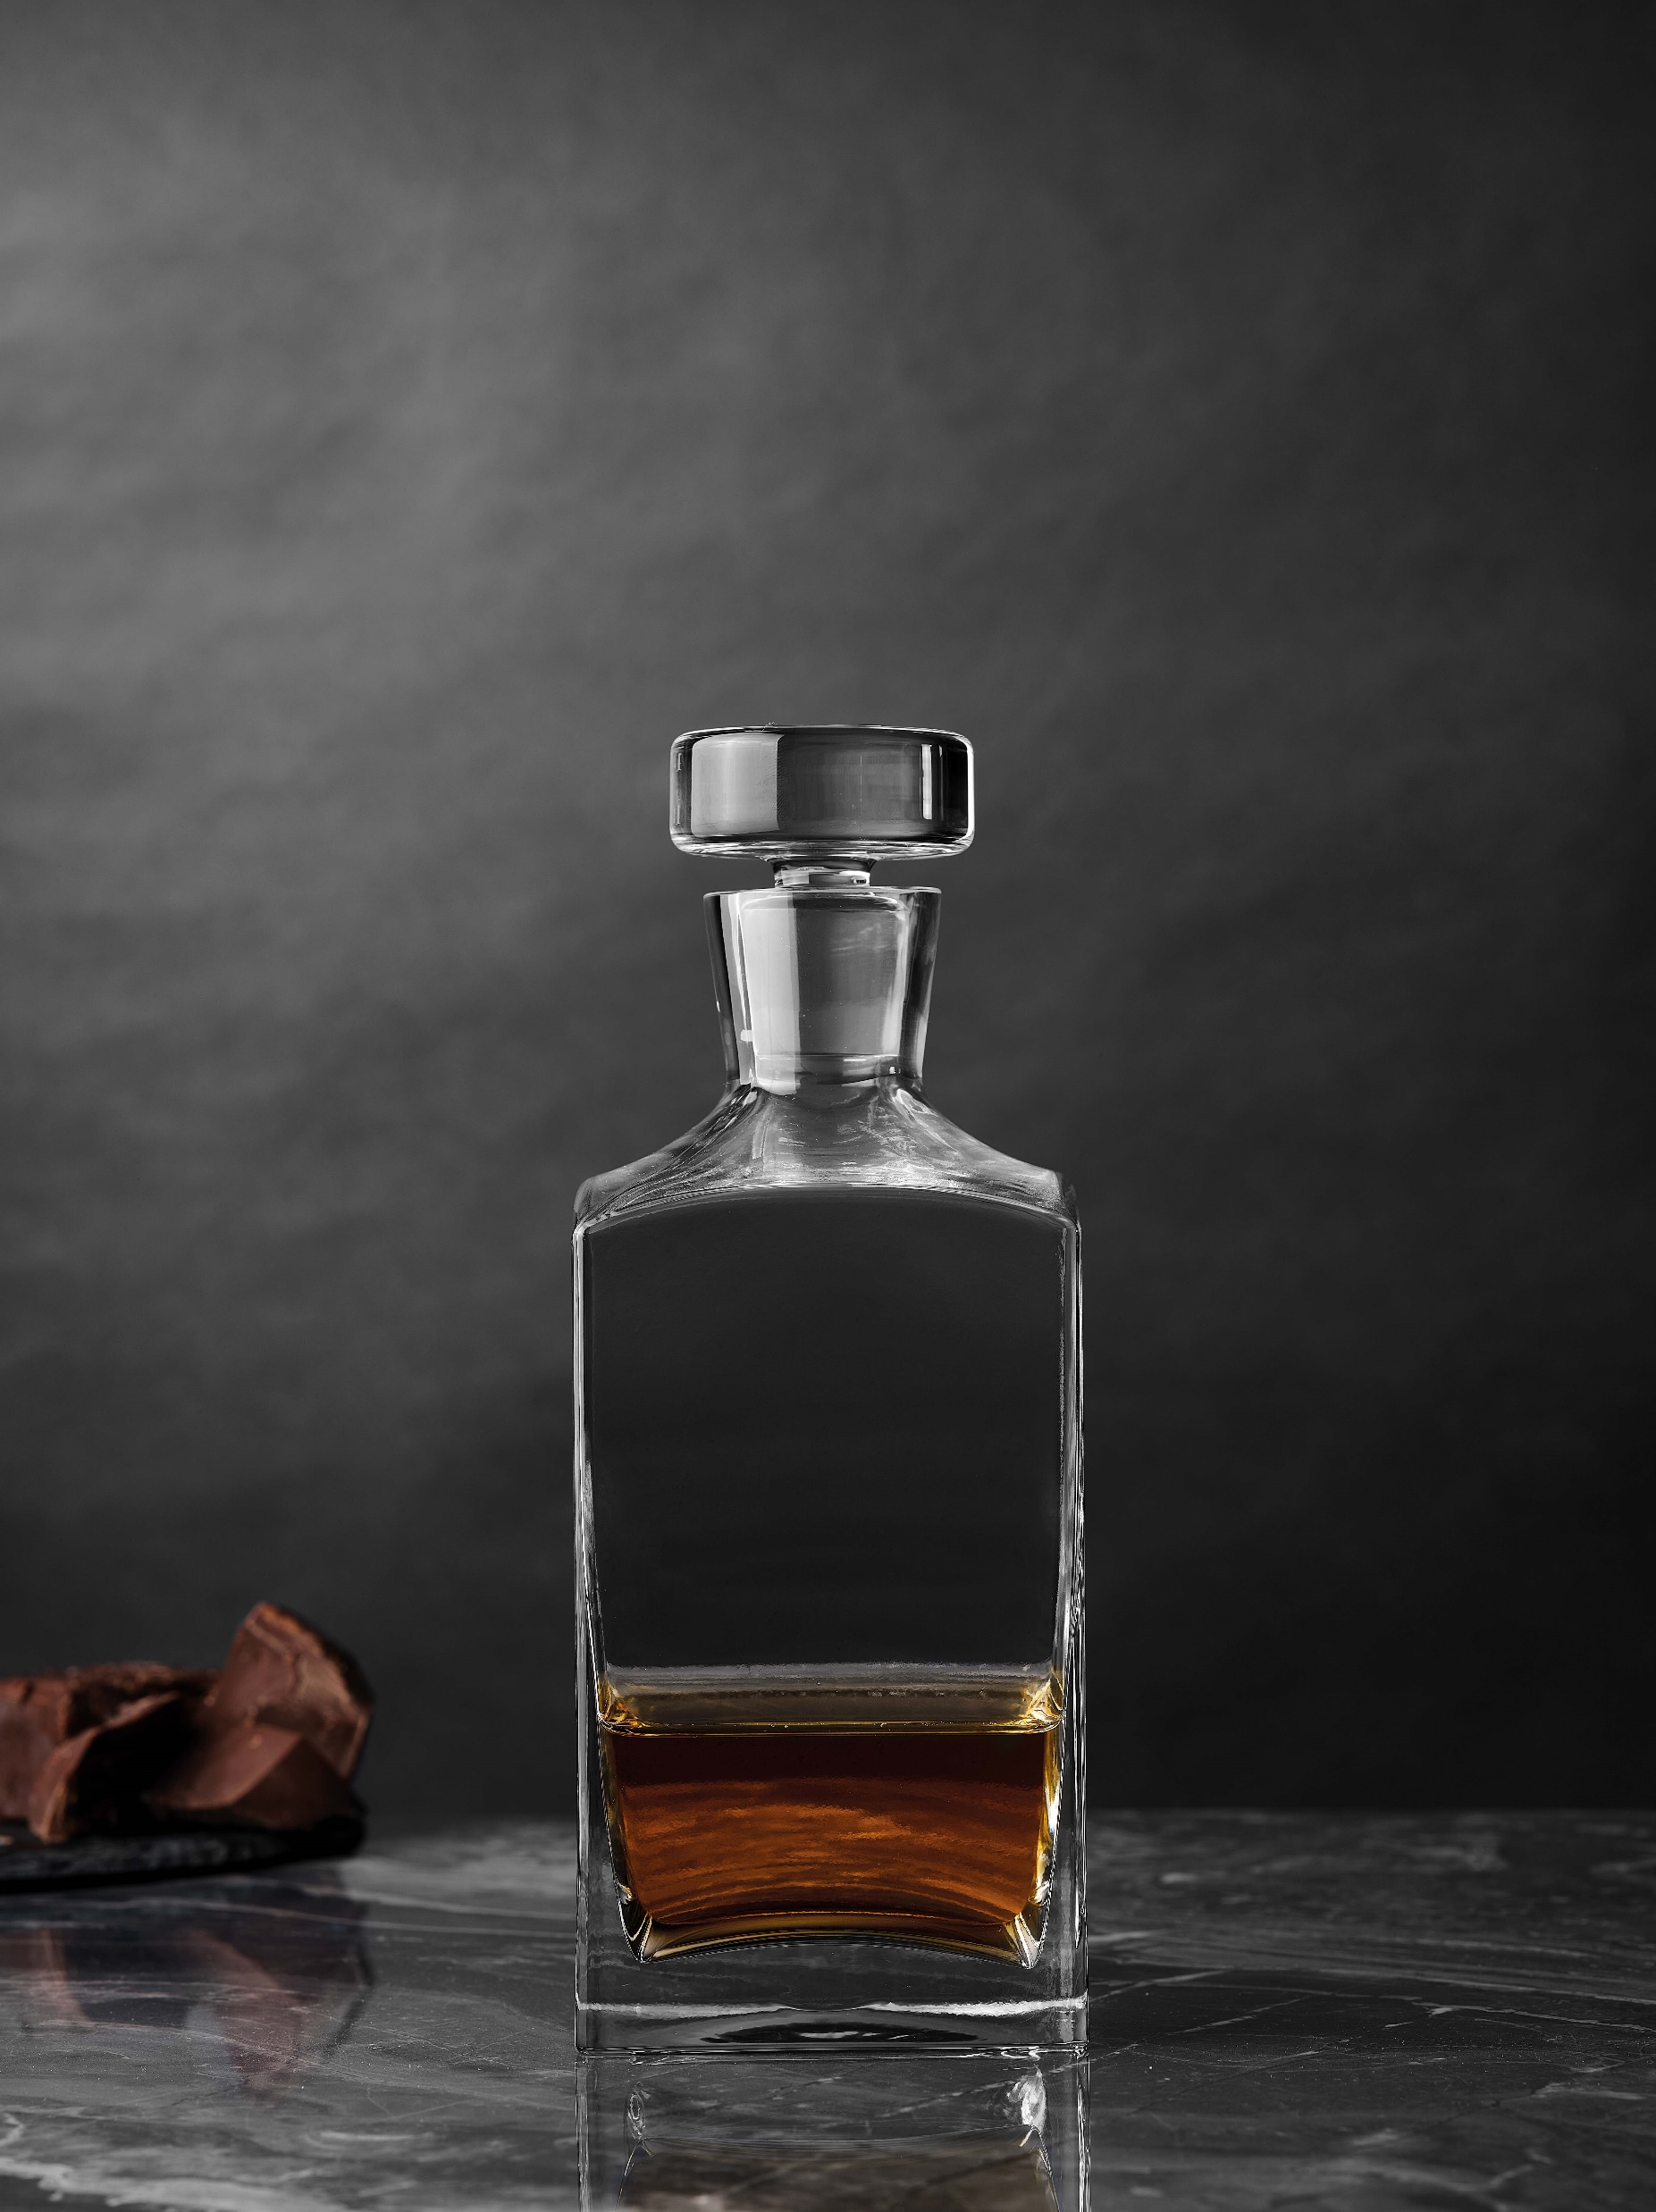
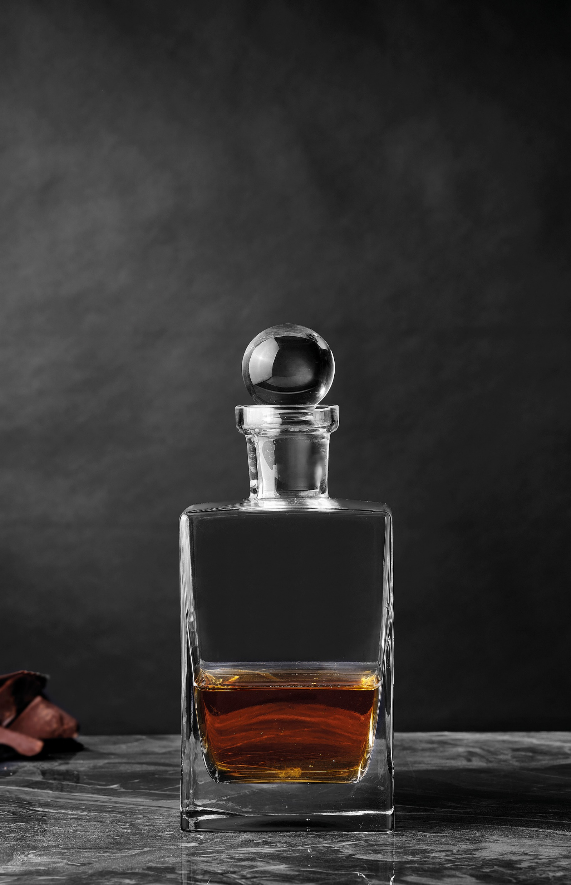
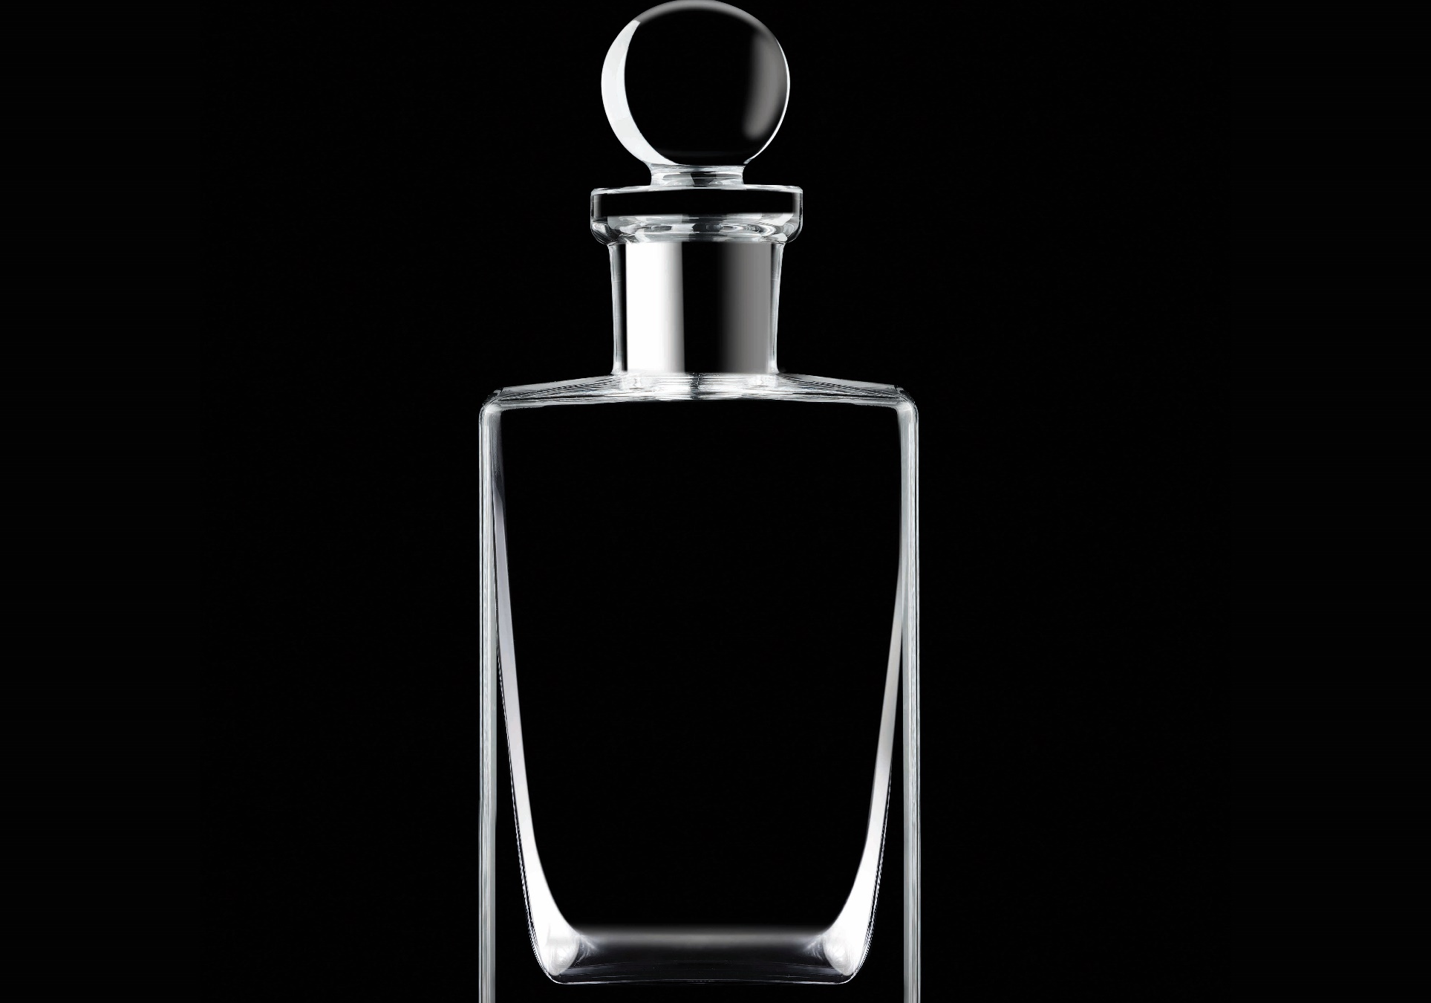
Paşabahçe crystallın handmade
92060 | 509601 | Prisma | 800cc
90321 | 1101070 | Scothland | 750cc
PRISMA SCOTHLAND

Slide 18
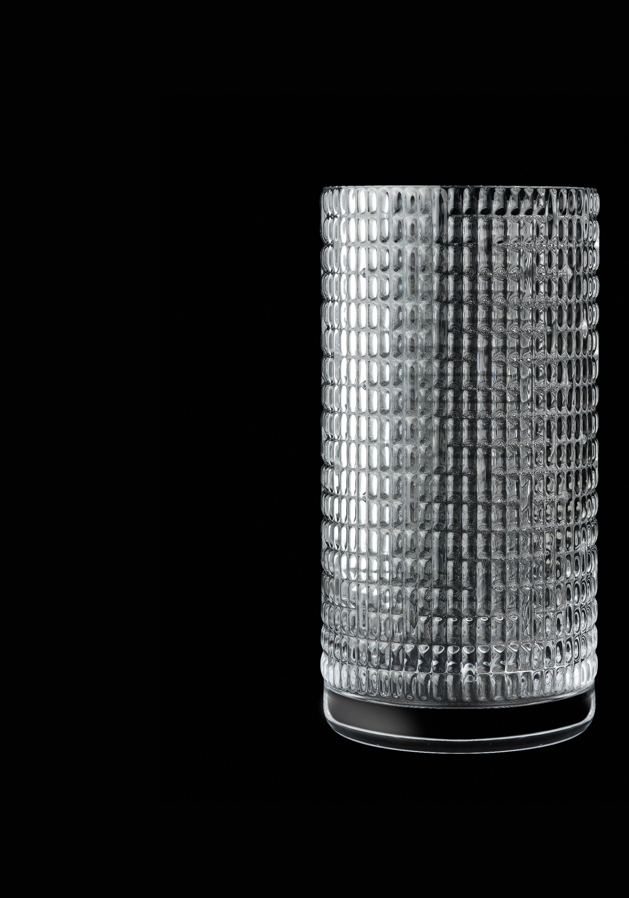
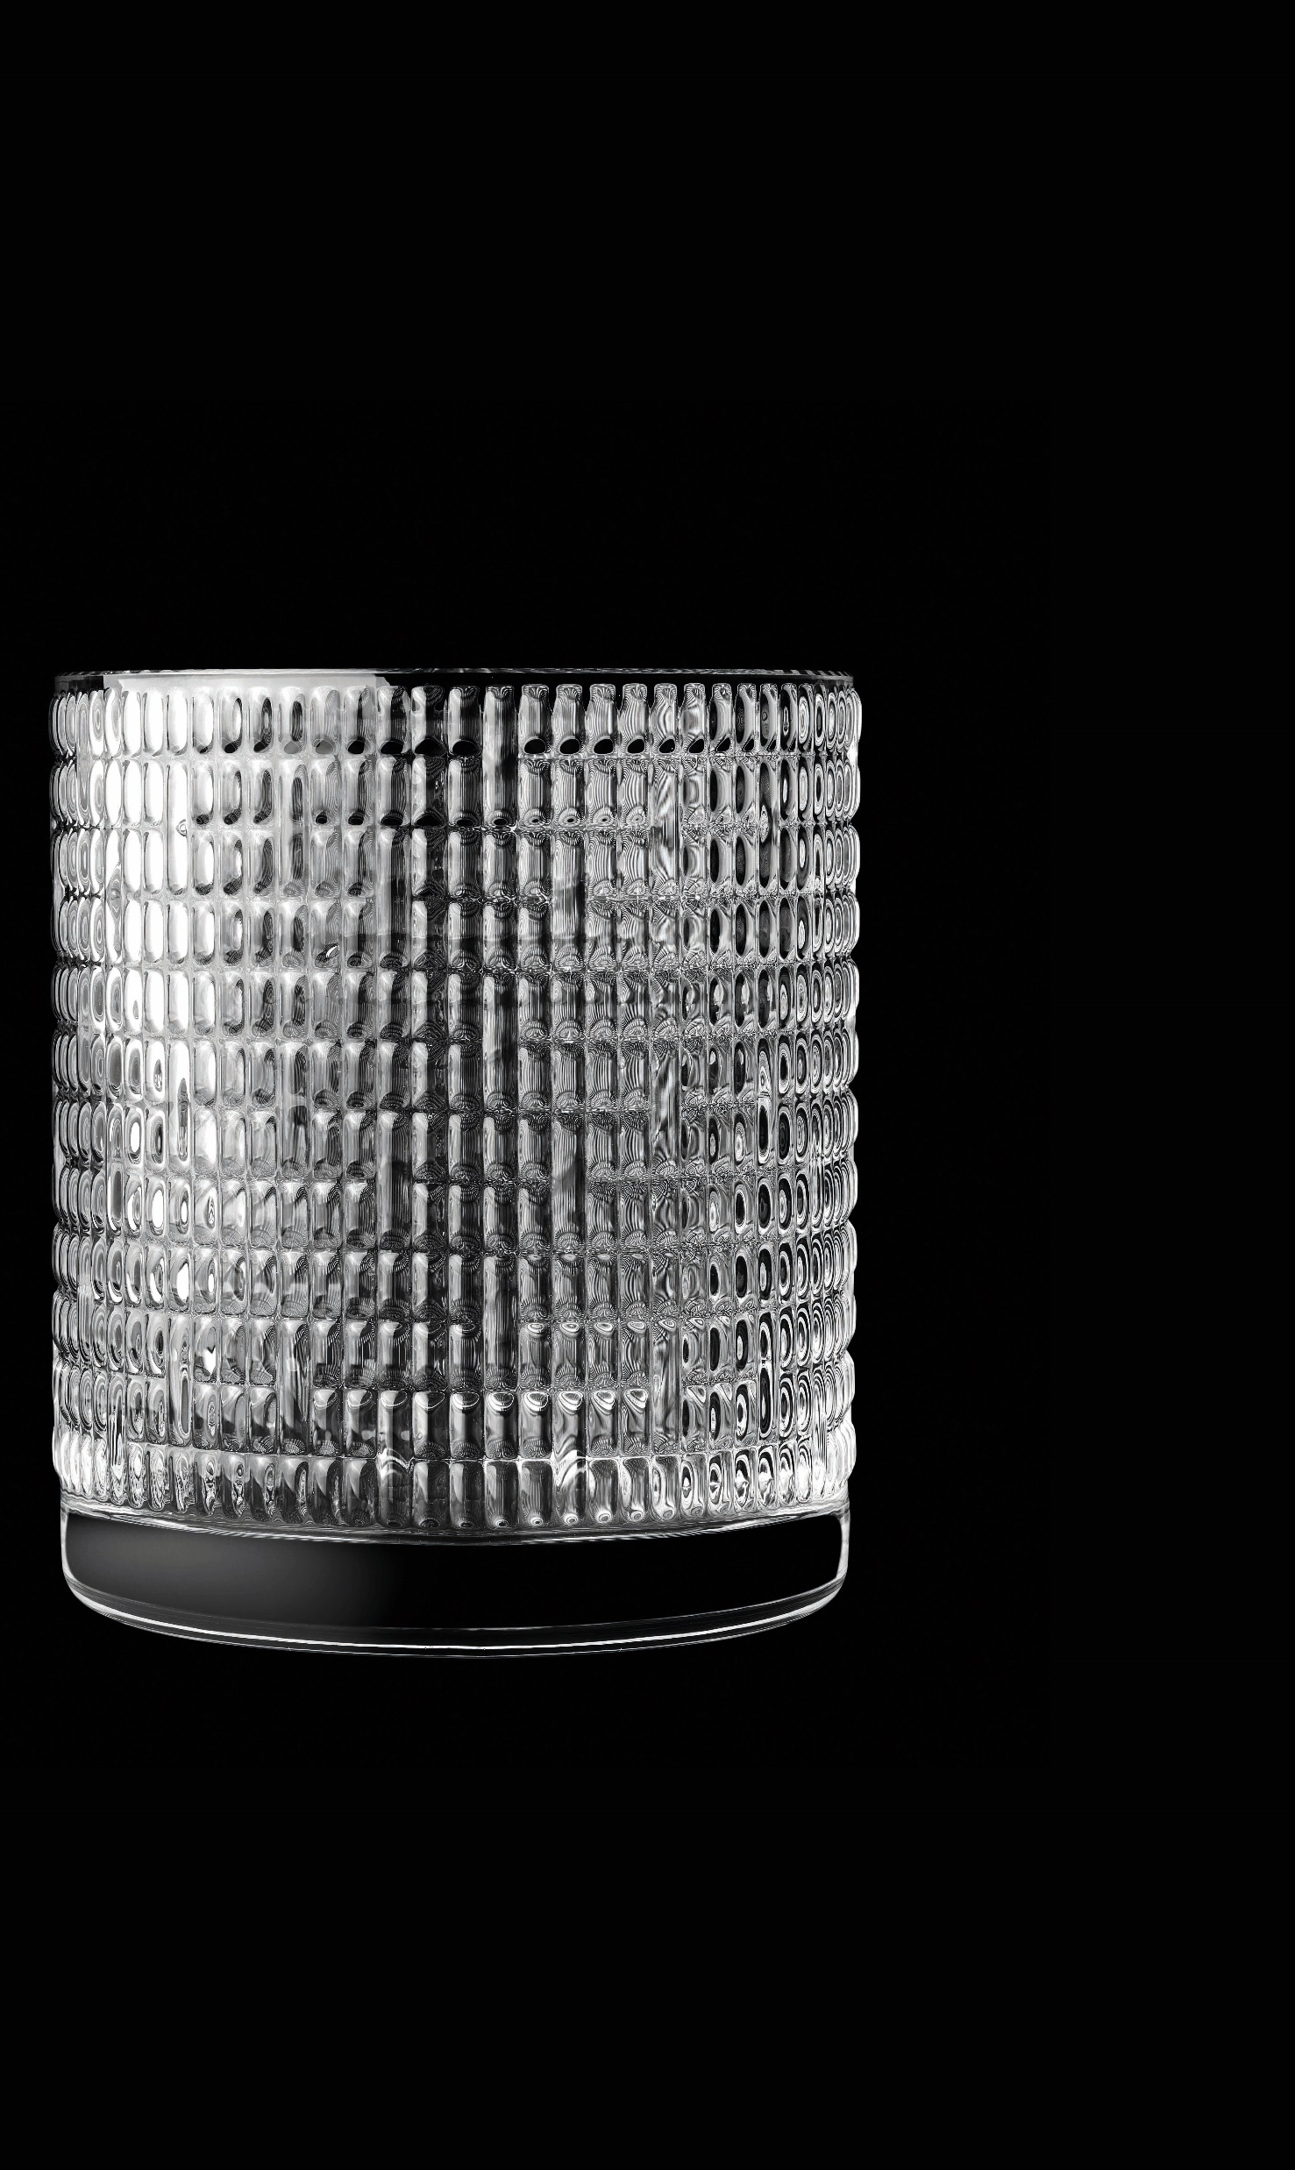
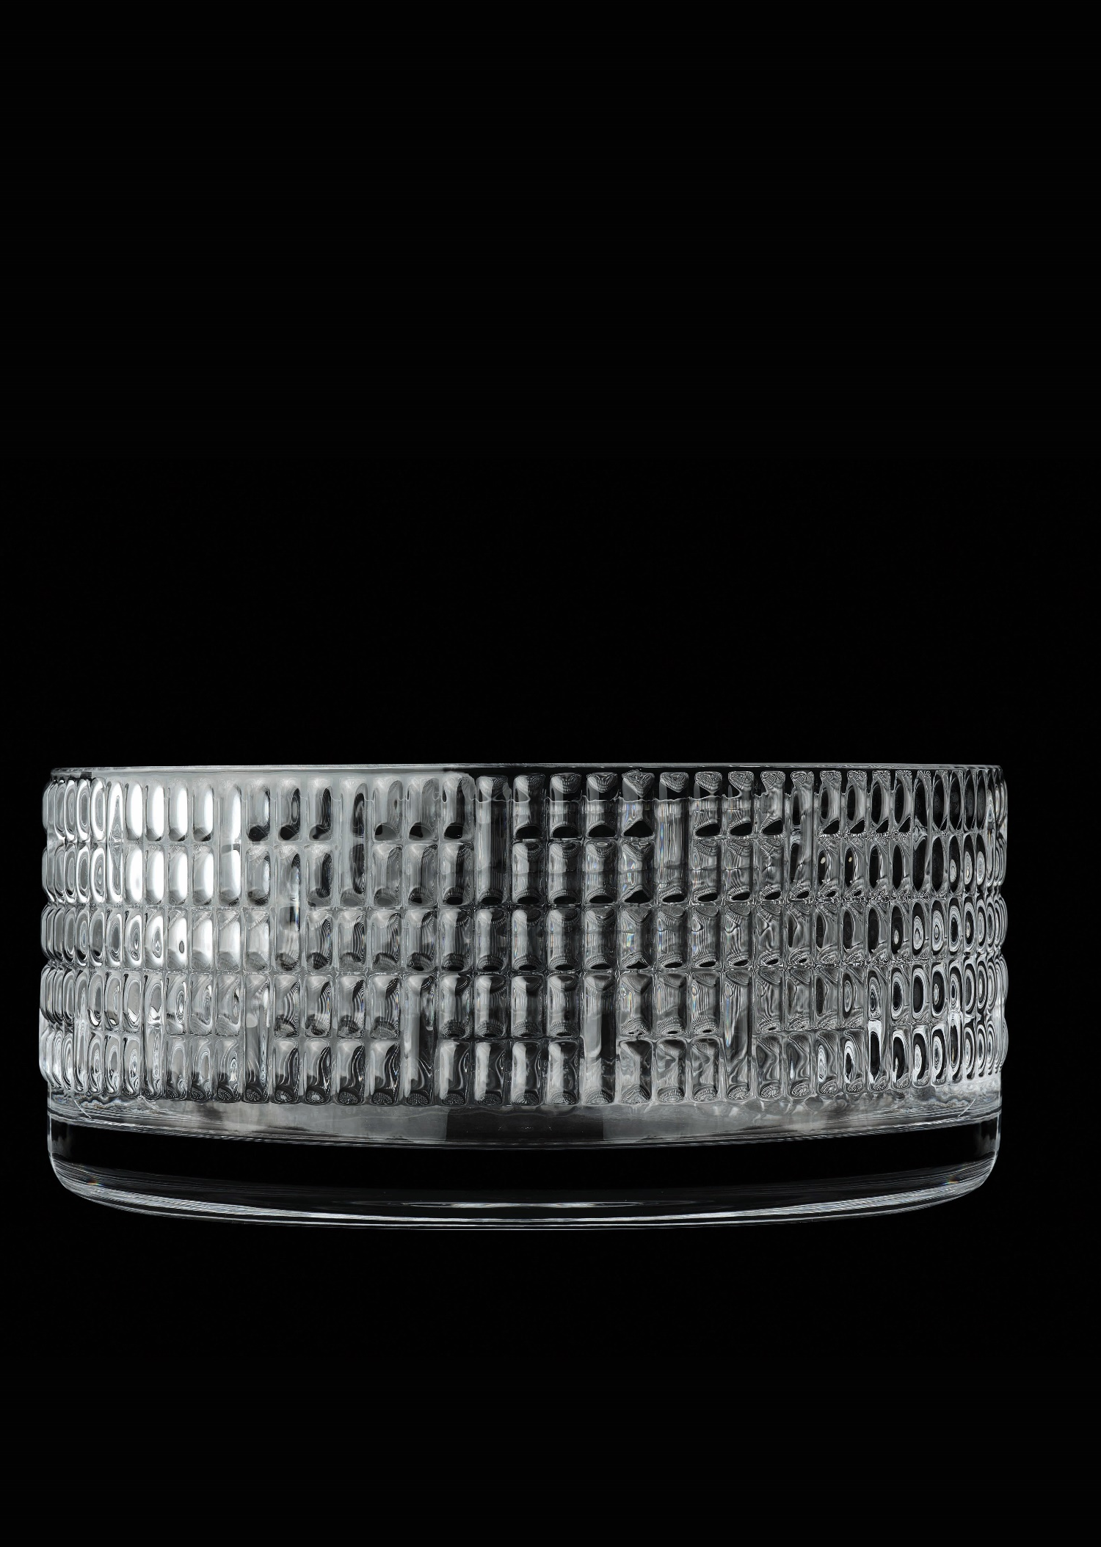
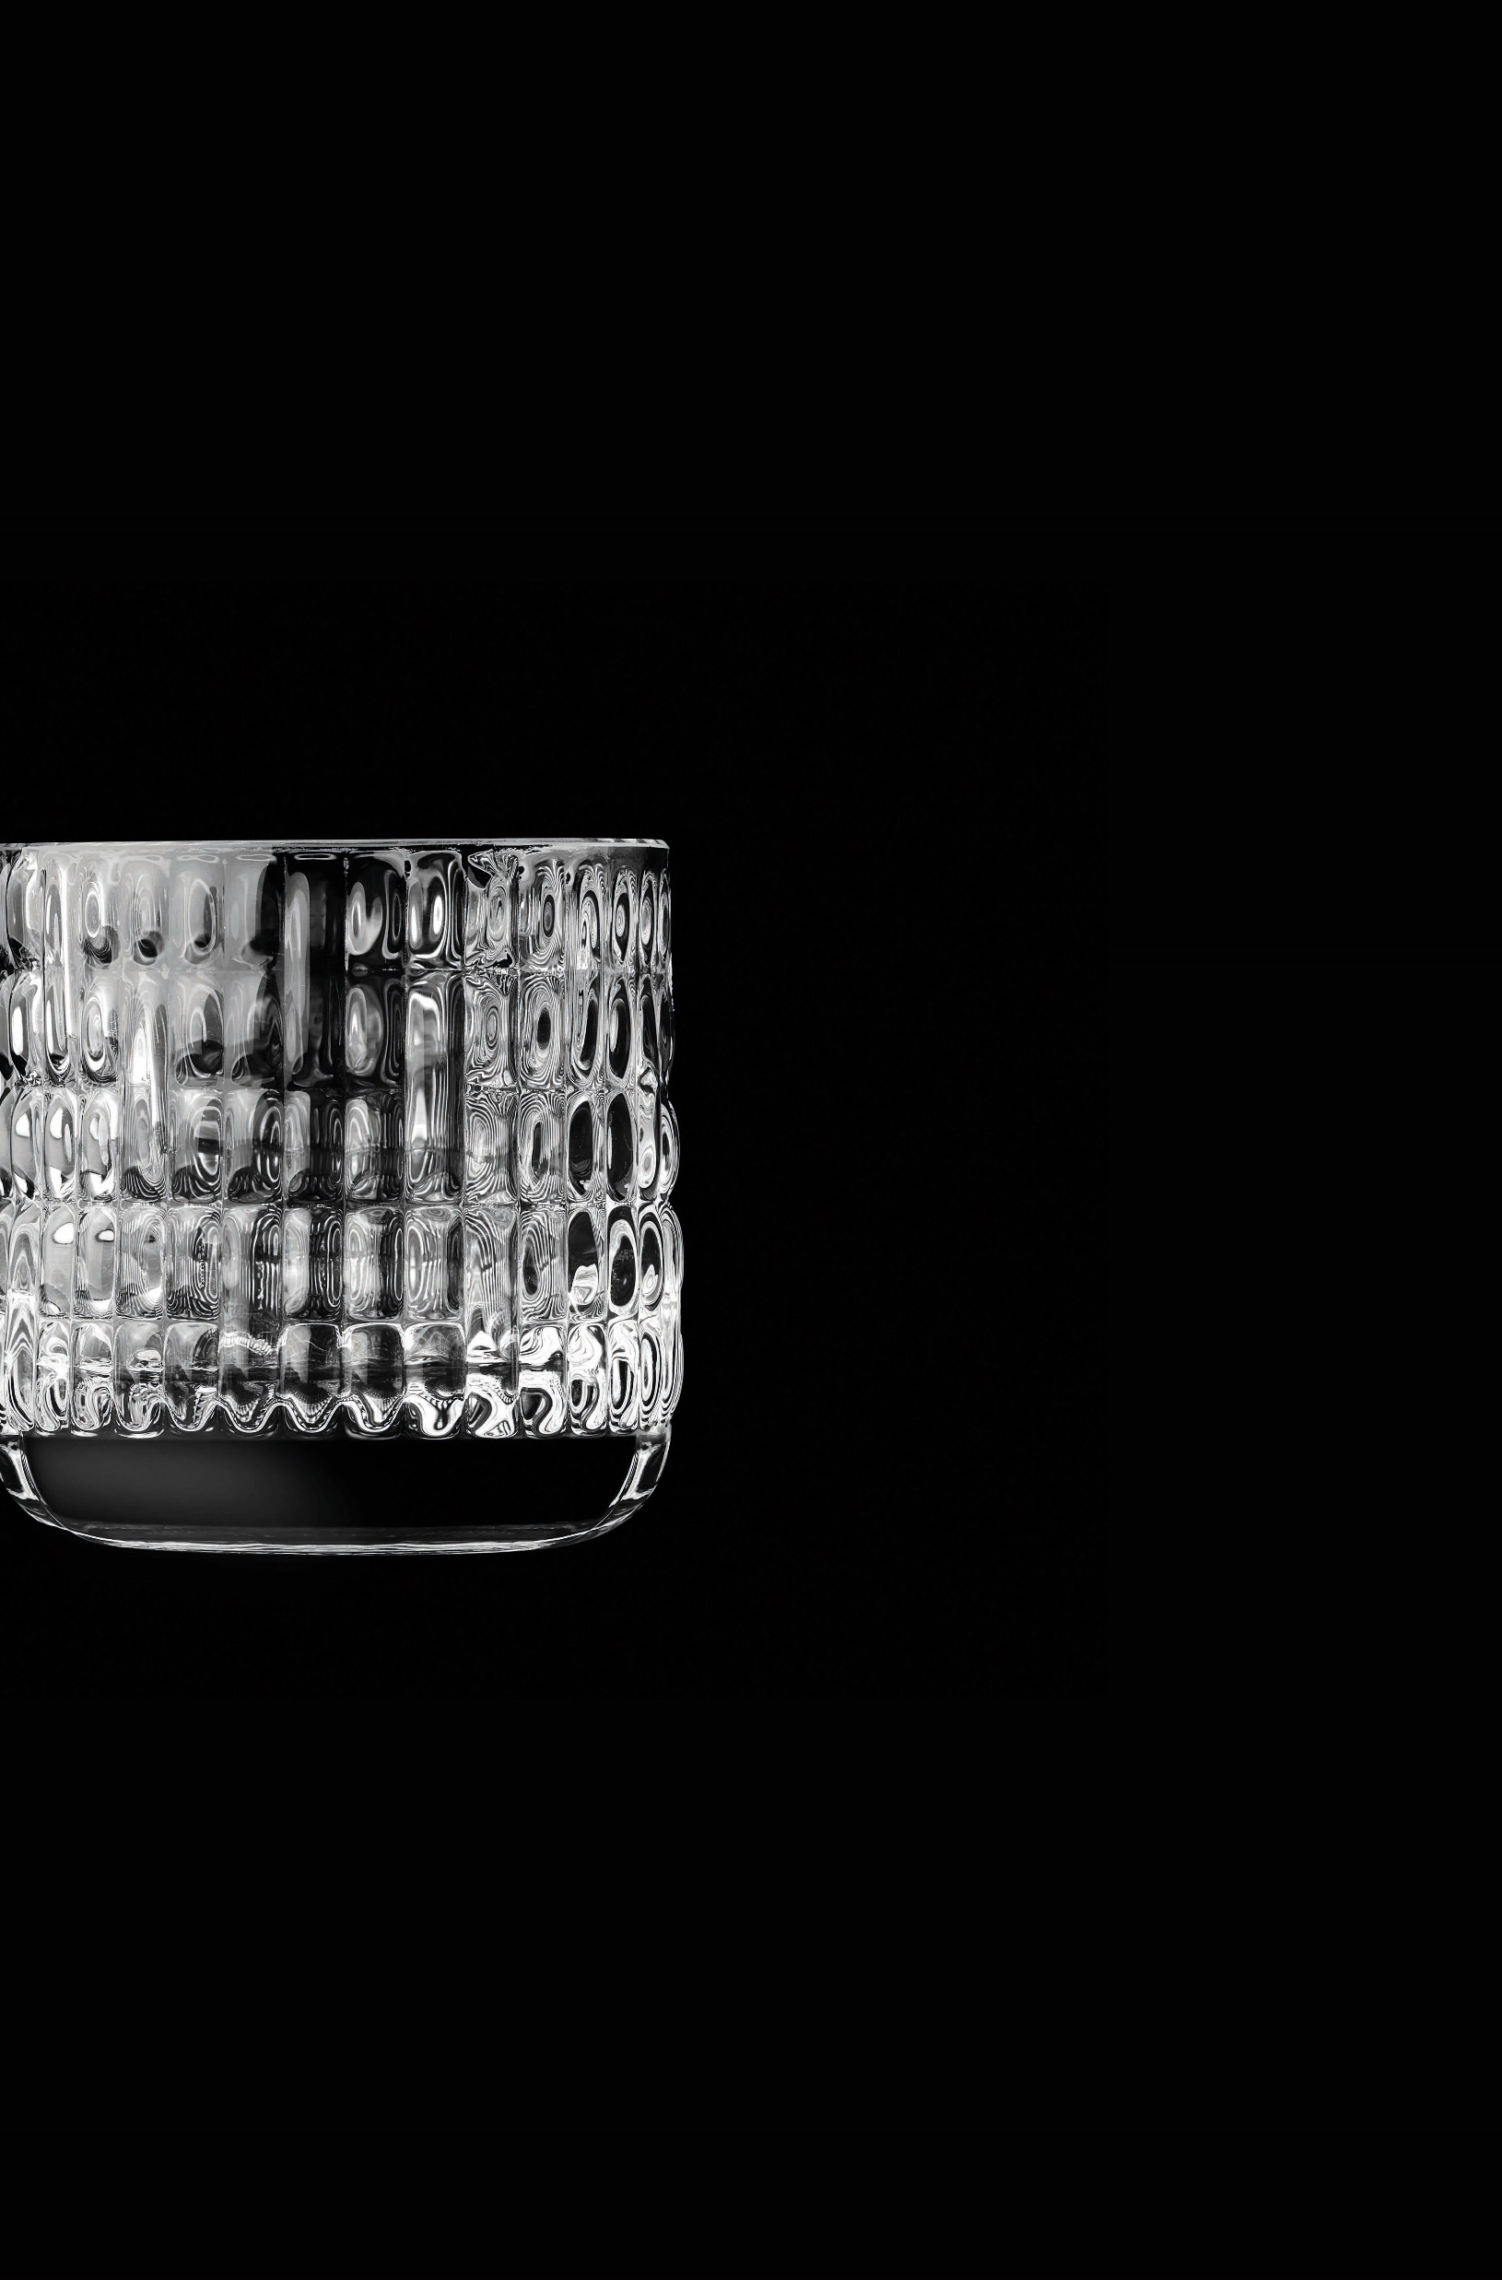
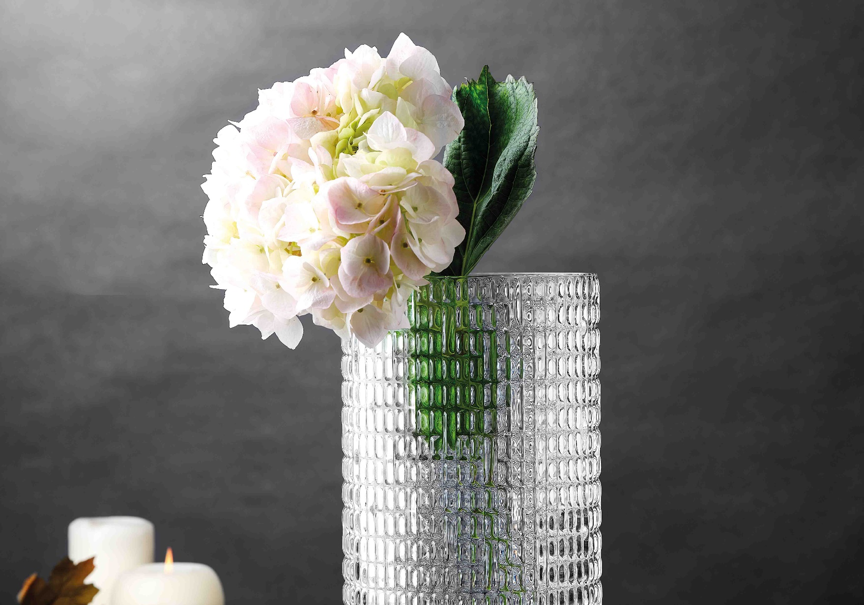
Paşabahçe crystallın handmade
PEONY
28706 | 1098311 | Peony | 180mm
28707 | 1098310 | Peony | 260mm
28708 | 1086626 | Peony | 71mm
28709 | 1098309 | Peony | 90mm

Slide 19
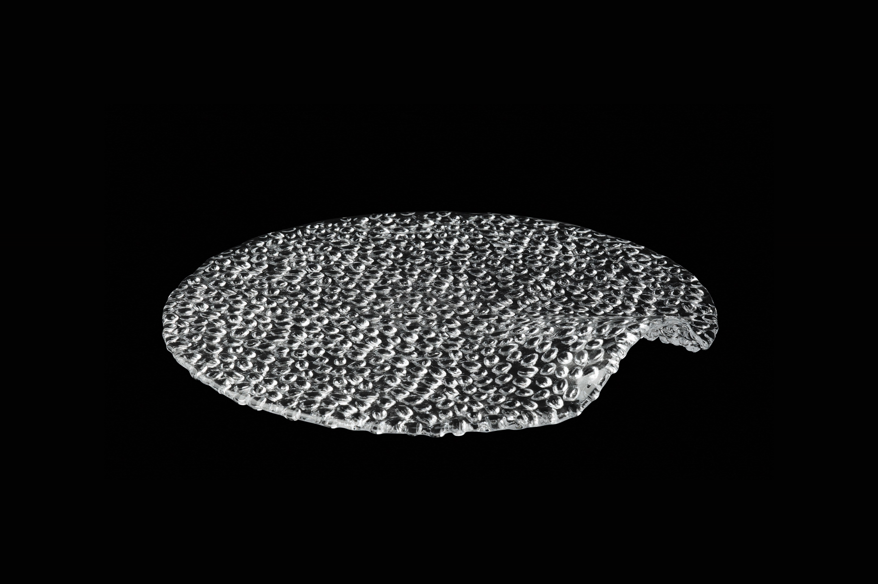
Paşabahçe crystallın handmade
PLATON
24324 | 1205113 | Platon | 210mm
24331 | 1205128 | Platon | 220mm

Slide 20
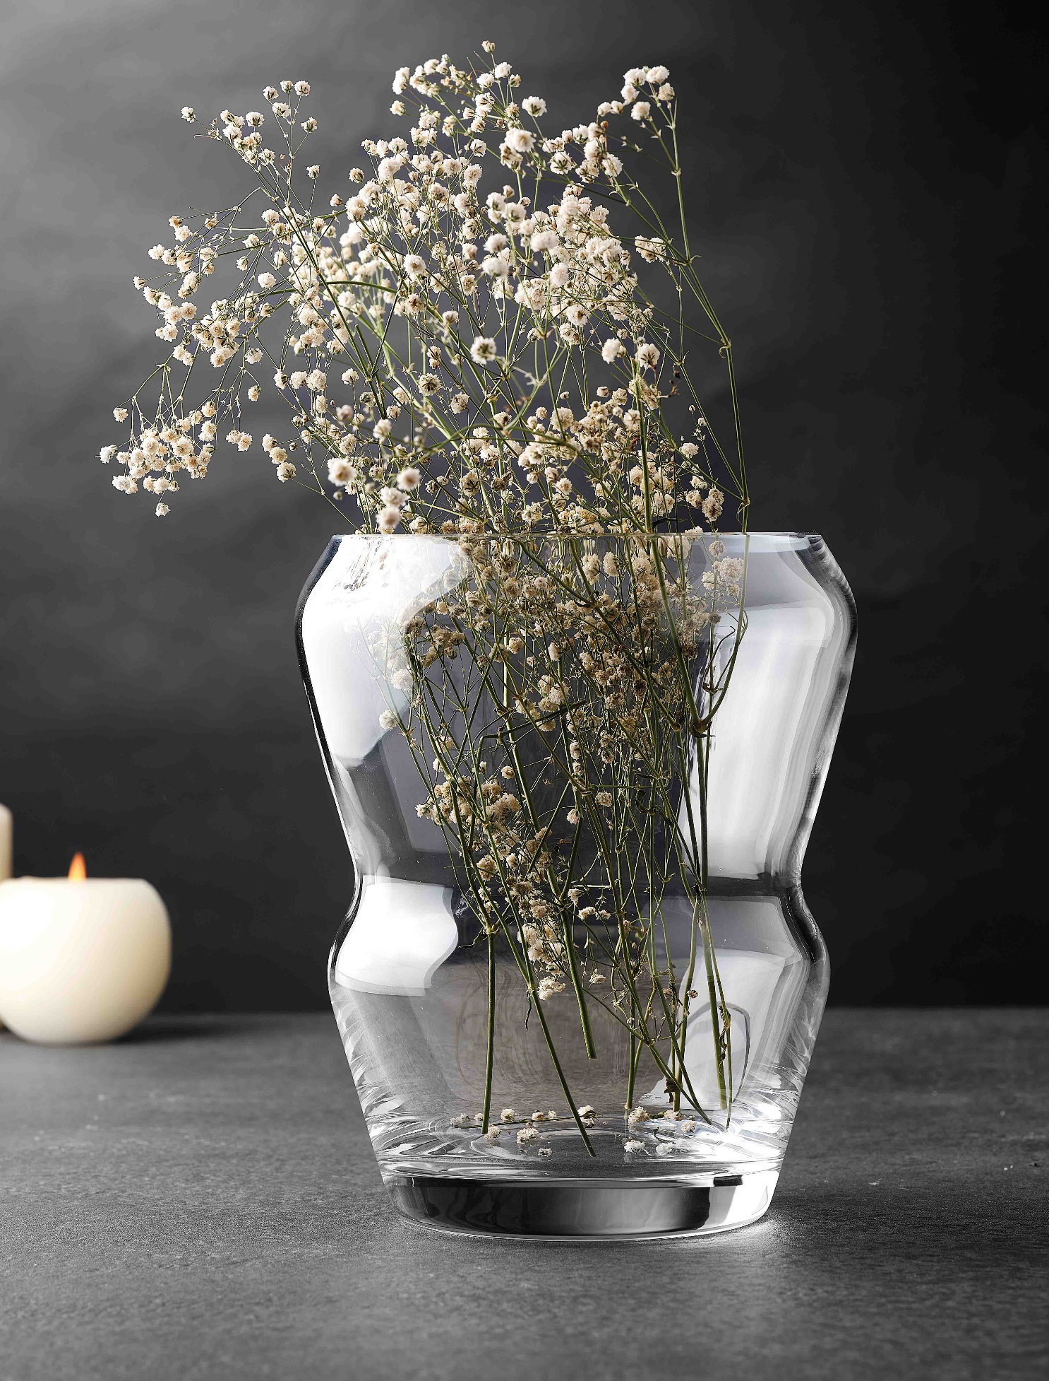



Paşabahçe crystallın handmade
PEKO
23536 | 1205078 | Peko | 280mm
23537 | 1205079 | Peko | 200mm
23538 | 1205080 | Peko | 260mm

Slide 21

Paşabahçe crystallın handmade
TORTE
28098 | 1205162 | Torte | 290X 90mm
28099 | 1205161 | Torte | 300X120mm

Slide 22


Paşabahçe crystallın handmade
TORCEDOR

Slide 23
Paşabahçe crystallın
Автоматическое пр-во

Slide 24








Paşabahçe crystallın
Machınemade
BEYKOZ
64031 | 1037888 | Beykoz | 88mm
64051 | 1037890 | Beykoz | 95mm
64061 | 1037904 | Beykoz | 210mm
64071 | 1038695 | Beykoz | 95mm
68047 | 1037886 | Beykoz | 17mm
68057 | 1037887 | Beykoz | 17mm
68187 | 1038697 | Beykoz | 20mm
98695 | 1205119 | Beykoz | 211mm
98961 | 1205120 | Beykoz | 212mm

Slide 25


Paşabahçe crystallın machınemade
LAVINIA
68236 | 1113037 | Lavinia | 95mm
68289 | 1120106 | Lavinia | 200mm

Slide 26
Paşabahçe crystallın machınemade
FACADE PLEATS
68126 | 1112636 | Facade | 154mm
68136 | 1112638 | Pleats | 161mm

Slide 27






Paşabahçe crystallın machınemade
REFLECTION
68168 | 1204997 | Reflection | 65mm
68197 | 1204995 | Reflection | 300mm
68217 | 1205009 | Reflection | 177mm
68328 | 1205008 | Reflection | 56mm
95461 | 1204994 | Reflection | 365mm
68129 | 1205007 | Reflection | 250mm

Slide 28



Paşabahçe crystallın machınemade
STELLA GLAMOUR
95467 | 1111232 | Stella | 100X100mm
95468 | 1111231 | Stella | 100X100mm
68001 | 1120128 | Glamour | 155cc

Slide 29







Paşabahçe crystallın machınemade
MADLEN
68153 | 1120163 | Madlen | 17mm
68307 | 1120104 | Madlen | 17mm
68317 | 1120105 | Madlen | 17mm
68683 | 1120100 | Madlen | 20mm
68693 | 1120102 | Madlen | 276X165mm
950007 | 1120101 | Madlen | 81mm
950008 | 1120103 | Madlen | 87mm

Slide 30



Paşabahçe crystallın machınemade
GRACE
68017 | 1204996 | Grace | 298mm
95462 | 1204993 | Grace | 298X140 mm

Slide 31
Paşabahçe crystallın
Новинки

Slide 32




SWORD
68485 | 1205180 | Sword | 345
68494 | 1205179 | Sword | 200
68504 | 1205181 | Sword | 335

Slide 33



CIELO
68474 | 1205182 | Cielo | 210
68475 | 1205168 | Cielo | 350
68484 | 1205183 | Cielo | 350

Slide 34
Спасибо!

